Slide 1
Assistant Head Recruitment Pack
Contents
Advert
Vision, Values, Purpose
Executive Principal Message
Our Trust
Safeguarding
Next steps
Please read this pack in conjunction with the job description and person specification.

Slide 2
Advert
Post Title: Assistant Head
Scale: L8-12 or L13-17 depending on experience
Start: September 2021
To support the development of our Partnership, we are looking to recruit an innovative, outward-facing leader with the experience and ability to lead a variety of improvement priorities across our Partnership.
The successful applicant will:
Manage a portfolio of projects with purpose and impact
Provide targeted support in identified areas
Lead in the development and delivery of our curriculum
Support the training of people and teams
We are looking for a highly motivated individual with the ability to build effective working relationships across a number of settings. If you would like to develop your career in an innovative and supportive environment, where children are at the heart of everything we do, please get in touch!

Slide 3
OUR VISION
A diverse, responsive, creative Partnership where the unique benefits of collective endeavour transform the lives of children.

Slide 4
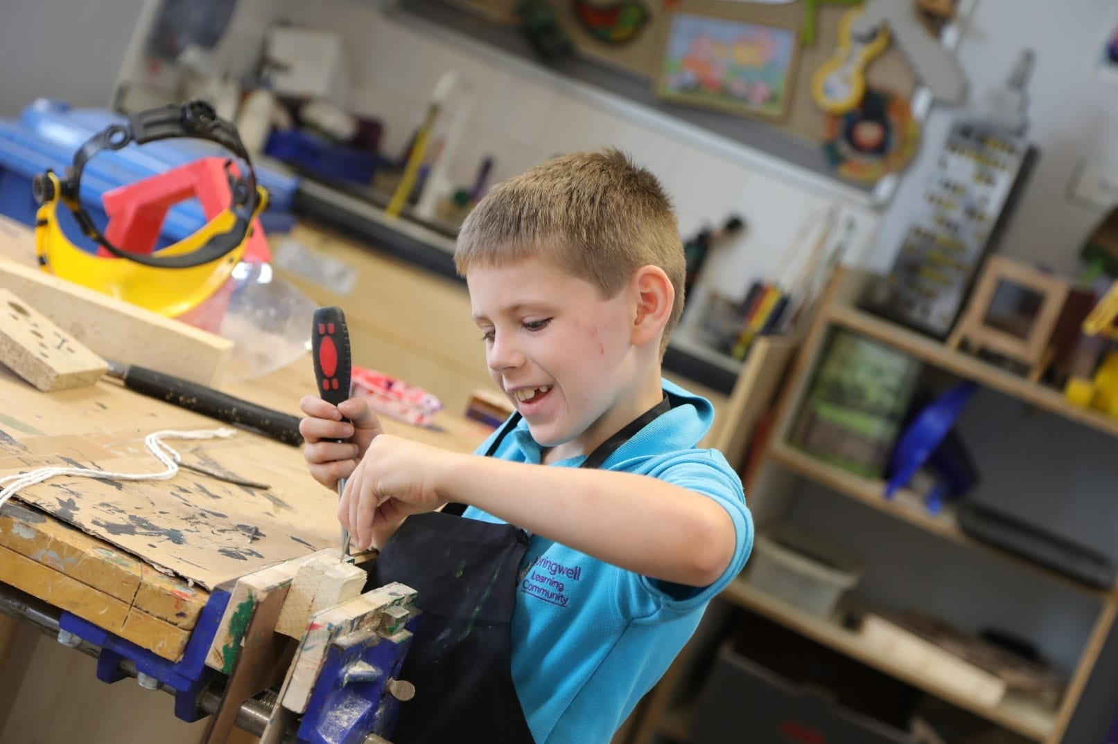
OUR VALUES
Integrity
Curiosity
Togetherness
Rigour

Slide 5
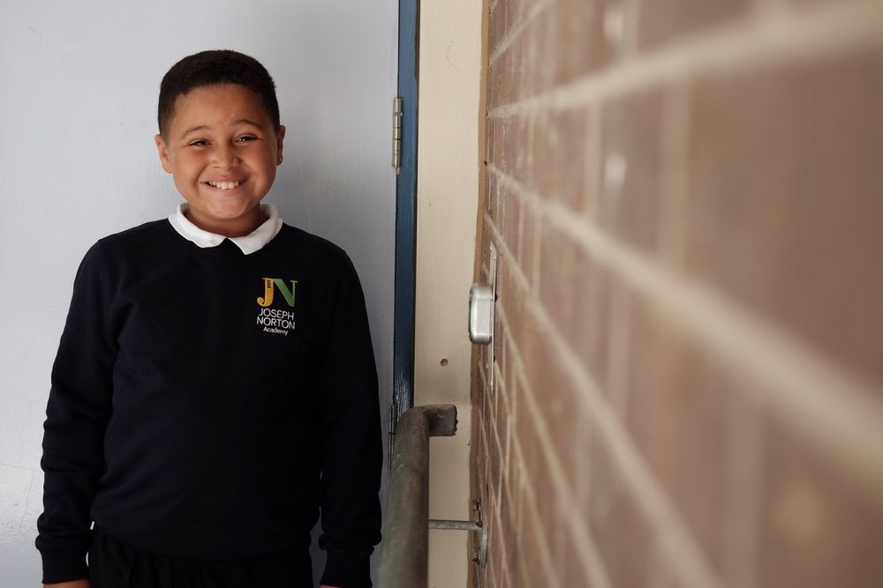
OUR PURPOSE
To strengthen the educational landscape by bringing people together
To enrich the educational experience through unique opportunities
To expand educational thinking through exploration, enquiry and research

Slide 6
Executive Principal Message
Hello!
It couldn’t be a more exciting time to join the Barnsley and Kirklees Special Provision Partnership as an Assistant Principal. We’re a bold, new partnership, formed through the collaboration of Greenacre, Joseph Norton Academy and Springwell Learning Community. Through our collaboration we are able to provide unique opportunities for our children, our staff and the communities we serve.
To be successful in this role you will require expertise in a broad range of areas. You will be a self-starter and have the ability to manage your own workload. You will need experience of leading on specific areas of improvement and the stamina to see things through.
Importantly, you will have the ability to implement change - forming and using targeted plans for the good of the children and the wider school community.
Please get in touch for an informal conversation about the role and the school prior to submitting your application.
Sarah Wilson
Executive Principal

Slide 7
At Wellspring Academy Trust we believe that every school is unique, because it has a unique history, it serves a unique community context and is full of unique individuals.
We value and celebrate the unique identities of our academies. We encourage them to innovate, create and develop their uniqueness because we want others to learn from them. Excellence is about diversity, not conformity.
We do not believe that one size fits all.
Our culture is: Open. Transparent. Outward-facing. Generous. Supportive. Collegial. Collaborative. Inclusive. Progressive. Plural. Courageous. Curious. Caring. Confident. Ethical. Respectful.
If you want to work with, and – more importantly – contribute to a culture like this, we might be a fit.
For further information, please visit our website.

Slide 8
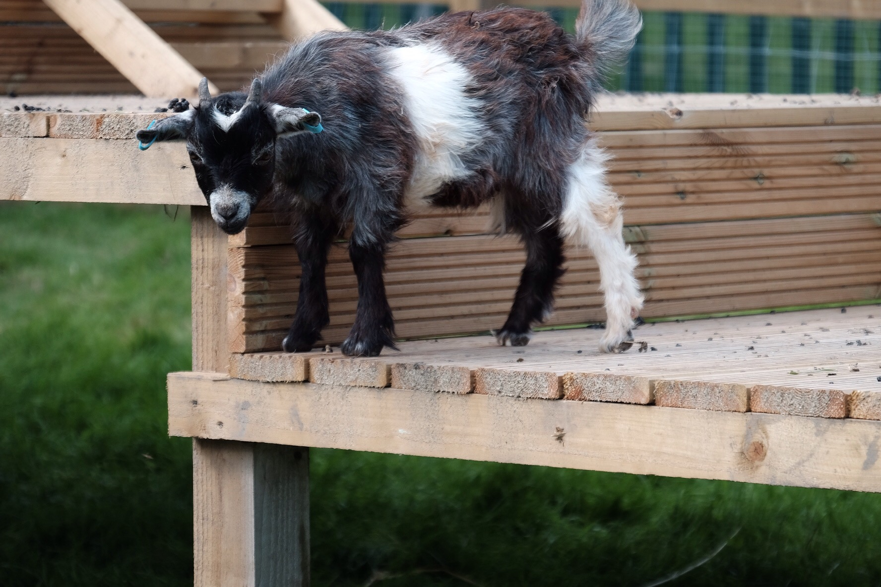
Safeguarding
Our Special Provision Partnership is committed to safeguarding and promoting the welfare of children and young people and expects all staff and volunteers to share this commitment.
We ensure that all our recruitment and selection practices reflect this commitment.

Slide 9
Next Steps
For more information about the role, please speak to Laura Flynn, Executive Vice Principal. To make an appointment, please call Sarah Elliot on 01226 291133.
To apply, please download and complete a Wellspring application form and submit, via email, alongside a letter of application. This letter should outline why you feel your experience makes you a strong applicant for this exciting opportunity. It should not exceed two sides of A4.
Please note that candidates are expected to demonstrate all the essential criteria and have strong communication skills.
Deadline for applications: 8.00am on Monday 21st June 2021.
Email for submission: springwellvacancies@springwellacademies.co.uk
Panel interviews, stakeholder interviews and associated tasks will be held on Thursday 1st July

