Slide 1
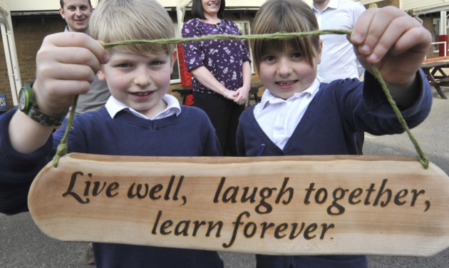
Headteacher Application Pack
December 2020

Slide 2
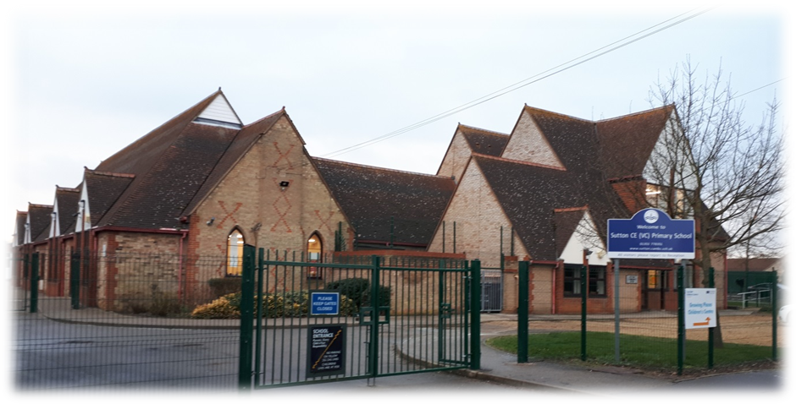
Index
 | Page
Letter from the Chair of Governors | 1
Information about our School
Our Vision and Values | 2
Our Organisation | 3
Our Premises, Grounds and Facilities | 3
Our Rich and Broad Curriculum | 4
Witchford Area Schools Partnership | 6
Parental Involvement | 6
Sutton - Our Village and Our Community | 7
Our Christian Ethos | 8
The Cambridgeshire Context | 9
Pupil and Staff Voices | 10
The Selection Process | 11
Job Description | 12
Person Specification | 16

Slide 3
Letter from the Chair of the Governing Body Dear Applicant We are delighted that you are considering applying for the Headteacher position at Sutton Church of England (VC) Primary School. We hope that you will find that the contents of this application pack are not only informative about the Headteacher role, which we recognise as key to a school’s ethos and success, but also convey the school’s character. As a primary school of currently 262 pupils, but expecting considerable growth due to new housing in the village, we have always been proud of the strong community feel. This extends from the involvement of the pre-schools in collective worship, to our Foundation Stage – Year 5 “buddy” system, to our close links with St Andrew’s church, to sustained engagement with parents, and to the involvement of members of the village community on our governing body, amongst many other things. Teamwork is at the heart of the school’s practices, between all levels of staff, between governors and amongst the pupils themselves. We are seeking to appoint a leader with a clear vision who will lead our dedicated staff team, working and communicating successfully with staff, children, parents, carers, governors and all who come in regular contact with the school. We are proud of the pupils’ behaviour and positive attitudes, as well as the broader curriculum offerings in music, sport and art, though there is a strong focus on continued improvement in core subjects. As a church school, Christian values are central to our purpose and vision. Our last SIAMS inspection in March 2019 recognised that the “The core values, explored daily in collective worship, drive the vision and have had a positive impact on relationships in the school” and the strength of links with the local church. Our new Headteacher will lead Sutton Primary School in providing an outstanding education throughout the school while ensuring the continuation of our Christian ethos. The information in this pack provides a taste of the school’s activities and character that can be supplemented by visiting our school website www.sutton.cambs.sch.uk where you can watch a recent video tour of the school on the front page. Further information on how to see our enthusiastic pupils and staff in action is provided later in the pack. We are also happy to receive informal enquiries regarding the post via Chair@sutton.cambs.sch.uk Applications for the Headteacher post should be sent to our Personnel provider, EPM, via headship@epm.co.uk by midday on Monday 25th January 2021. Please note that CVs will not be accepted. We will shortlist the following Friday and invite successful candidates for assessment and interview on Thursday 4th and Friday 5th February 2021. Many thanks for your interest and I look forward to meeting you, Hilary Sanderson Chair of the Governing Body

Slide 4
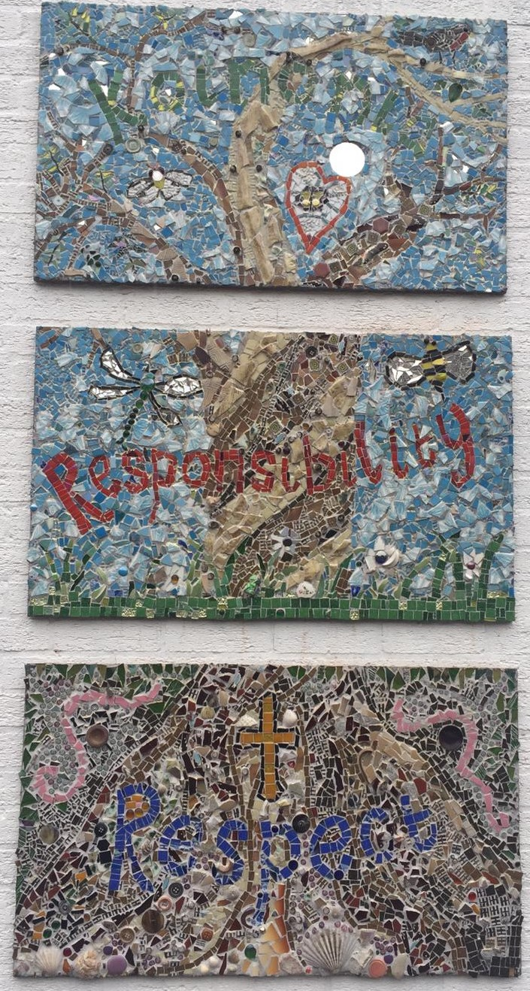
About Our School - Vision & Values We are a learning community – all here for the common purpose of growing as individuals and collectively - both in knowledge and skill as well as spiritually; we work together to rise to challenges – helping and encouraging one another to flourish; taking joy in and celebrating our successes. We design our curriculum to ensure that: all our children nurture a respect for all God's children and love of our local and global neighbours, developing a sense of personal and collective responsibility to contribute towards the world God intended for us. Our central value of Respect is the foundation of our school purpose, as well as our one rule: At Sutton School we choose Respect: Respecting ourselves: by being the best we can in all we do. Respecting others: by loving our neighbours as unique individuals. Respecting the environment: by looking after God’s world and everything in it. As well as respect, our values are encapsulated in five key words: Love: We love our neighbours (community) and are caring and compassionate; We value all God’s children (diversity); We love our learning; We are forgiving and seek to enjoy our time together in and out of school. Peace: We promote prayer and reflection; gentleness, self control and patience; We practise peaceful problem solving and mediate through talk and reflection when issues arise; We strive to make Sutton School a nurturing place in which pupils can feel safe and secure. Trust: We are honest and trustworthy; We are responsible and reliable; We trust and have faith in ourselves and are resilient, persevering and supporting of each other to overcome challenges; Koinonia: (A Greek word that means fellowship and friendship, community and communion) We promote fellowship as a united community of shared and differing beliefs, interests and ideas. We are all committed as lifelong learners and we share, contribute and participate wholeheartedly in action for change, making life better for those we can. Justice: We act fairly towards one another and work to make sure that all voices are heard; We strive for equity and equal opportunity, ensuring that each individual child is nurtured and supported according to their skills, talents and needs.

Slide 5
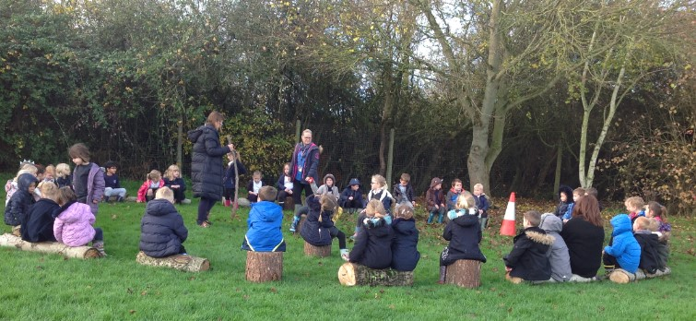
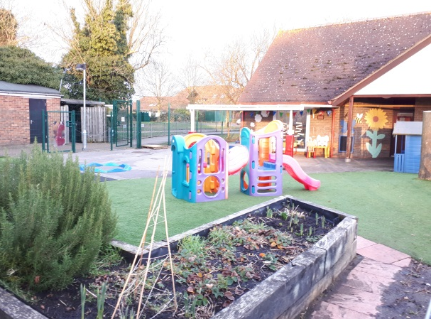
Organisation The school has a pupil admission number of 45 per year group, with an average of 320 pupils on roll in recent years, although the current roll is 291. Due to varying numbers in different year groups, the structure can change from one year to another. In the 2020/21 academic year we are operating one class of EYFS pupils with three mixed year classes in Key Stage 1; Key Stage 2 is split across six classes, three lower KS2 and three upper. Teachers work closely together planning a broad and balanced curriculum for the year groups. We utilise a variety of approaches in order to realise each child’s potential. The Senior Leadership Team work collaboratively with the governing body. Some teachers have specific whole school subject leadership responsibilities. Many of our talented teaching assistants have specialisms, such as literacy or SEMH needs. We have a strong team of support staff including dedicated office and finance personnel. Our premises, grounds and facilities As a traditional village school, we are proud of our extensive grounds which include a large sports field, an outdoor classroom, an adventure playground and an allotment area with fruit trees. We also have a specific garden for our EYFS pupils which offers allotment beds, hardstanding and artificial turf. Our playground areas include a large open space with basketball hoops, smaller sheltered quiet areas with benches, a small running track and various games. Our walls are decorated with murals as well as a traversing wall. We are very proud of our new mosaic displaying the school’s values. Our buildings include a large, open and well-lit hall, kitchens, a library, a dedicated music room and a well-equipped staff room. We also have a dedicated setting, The Bridge, for children with particular needs. The school was a Victorian building but has had many additions and alterations. The community room, added during major re-building works in the 1990s, belongs to the parish council. It is used by many community groups and is also available to the school.

Slide 6
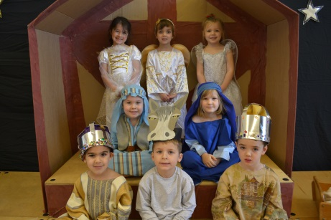
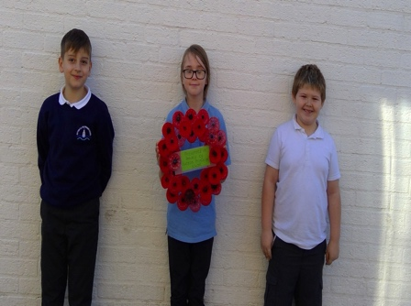
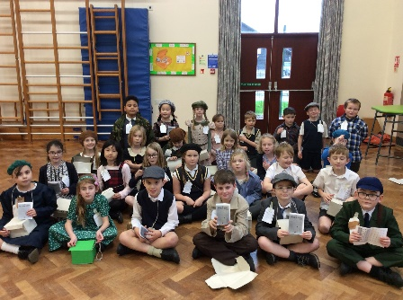
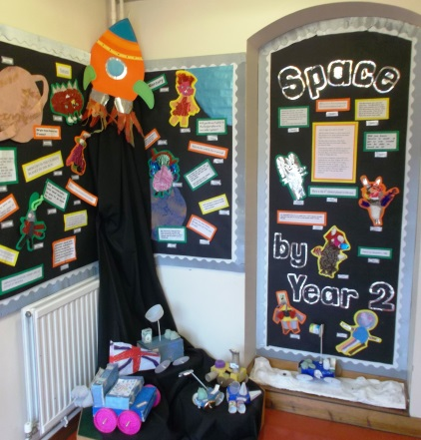
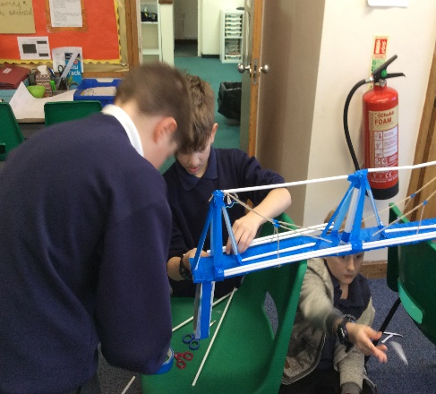
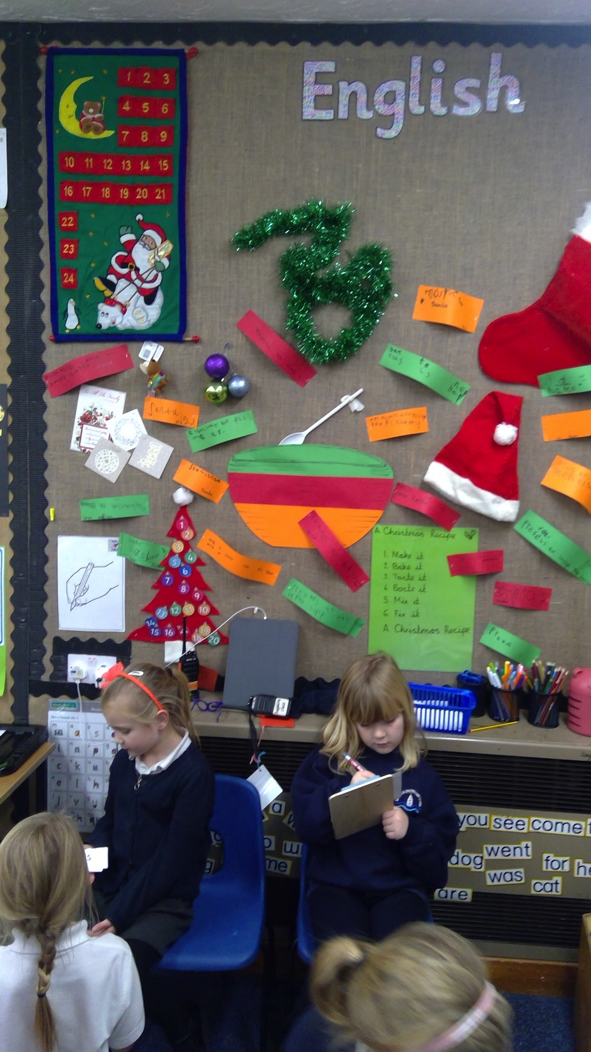
About Our School - Our rich and broad curriculum You can download our most recent OFSTED inspection report and SIAMS inspection report from our school website, http://www.sutton.cambs.sch.uk/website Core Topics Using a cross-curricular topic as a base, our teachers use traditional and innovative methods to teach core subjects. Music and Performing Arts The school has a thriving musical culture. As well as devoted music lessons in class time, many pupils have lessons and take examinations in range of instruments. In non-Covid times, there is also a thriving afterschool recorder club, whose members regularly compete with great success in local music festivals. There is a regular music concert during the year and all pupils have a chance to act, dance or sing in various productions at Christmas or in the summer. Art Art is a significant part of the school curriculum as seen in displays around the school. Each year we have an art week when we usually have a visiting artist to give new ideas and inspire new works. All classes have weekly art lessons and create two and three dimensional works with painting, drawing, collage, clay, fabric and natural materials, as well as computer-based design work. We have our own pottery kiln on-site. Science Science is taught on a weekly basis. Each year we have a focussed science week with exciting themed activities; pupils have enjoyed making bridges and last year they were involved with a Space theme at Ely Cathedral! Some years we have had visiting scientists to demonstrate experiments and talk about their work.
Wreath created by children from recycled plastic bottles, presented as part of the village Remembrance Service

Slide 7
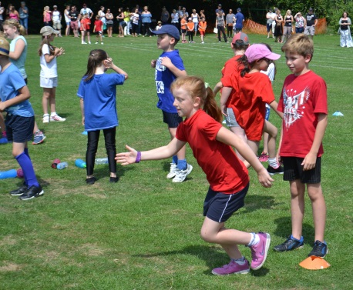
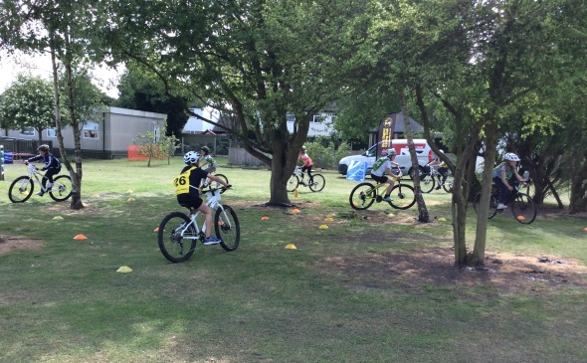
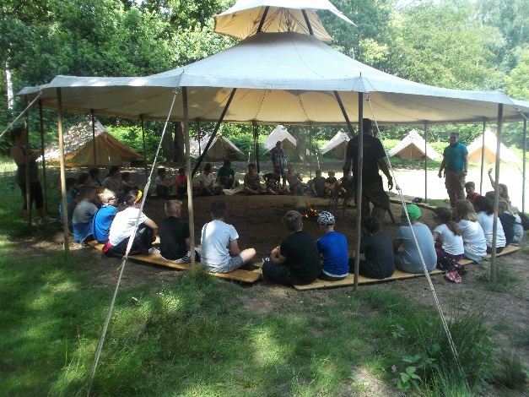
About Our School - Our rich and broad curriculum Sports and Physical Education Twice-weekly physical education lessons range from football, netball and rounders, to athletics, gymnastics and dance. We also provide swimming lessons at a local pool and run annual ‘balanceability’ and ‘bikeability’ courses. As a ‘catchment area’ primary school to Witchford Village College the pupils at our school benefit from the Sports College Status awarded to Witchford Village College. We pay an annual Service Level Agreement that entitles the school to a range of resources including: training courses, in-school coaching sessions and access to sports festivals and tournaments. During the year qualified sports coaches run sessions before, during or after school, which are designed to encourage pupils to adopt a healthier, more active lifestyle, and to try different types of sports. The staff at our school are also able to attend PE courses run by Witchford Village College to maintain a high level of PE teaching at the school. In the summer we run Sports Days for each Key Stage - these events are well-attended by families, and also include local pre-schools. Outside of specific PE lessons our pupils are encouraged to take part in a variety of activities during playtimes. In addition to these activities, Year 5 pupils are also encouraged to volunteer as Playground Leaders. These pupils undertake a training course run by school staff and are then able to help organise lunch time playground games for younger pupils under the supervision of a member of staff. Towards the end of Year 6, our pupils attend a three-day residential trip, most recently a Bushcraft course where they were able to take part in a range of exciting “survival” focused activities!. We offer a wide variety of additional after school activities; the sports available change from term to term (currently on offer are archery, football, gymnastics, dance, and musical theatre). Personal, Social and Health Education & Personal, Social and Emotional Development Our strong tradition of pastoral care is followed through with a progressive curriculum based on the PSHE service’s Personal Development Planner. This ensures all aspects of the curriculum are taught using a range of approaches including stories, role play and Circle Time. In addition, we have an annual PSHE themed week with diverse topics including anti-bullying, healthy eating, building self-esteem and financial capability.

Slide 8
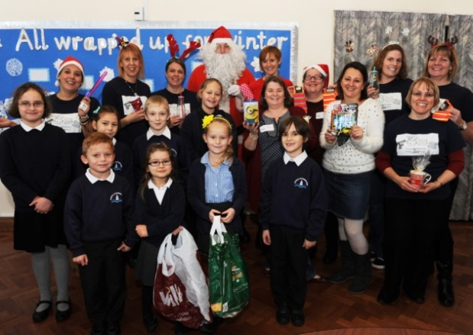
Witchford Area Schools Partnership As a primary school in the Witchford Village College catchment area we are one of nine schools that make up the Witchford Area Schools Partnership (WASP). The partnership consists of: • Primary Schools: Little Thetford CE Primary School, Mepal and Witcham CE (VC) Primary School, Robert Arkenstall Primary School, Stretham Primary School, Sutton CE (VC) Primary School, The Rackham CE Primary School and Wilburton CE Primary School • Special School: The Harbour • Secondary School: Witchford Village College The Headteachers within the Partnership meet approximately once per half term to discuss current issues and actions on the Partnership Plan. Our members of staff also meet, for example, there is a SENDCO Group, an NQT Group, joint training for TAs and cross-school moderation. The Partnership Plan is produced annually and aims to take common issues and address them through a variety of joint actions. This year there has been a focus on Science with all the schools coming together for a joint half day INSET to look at practical science activities that can be undertaken easily within the classroom setting. Parental Involvement Friends of Sutton School, otherwise known as FOSS, are a group of parents, teachers and friends who have formed a committee to raise funds for school equipment to enhance the children’s education and to improve the school’s environment. As a Registered Charity they also aim to promote and foster good relationships within the community. Over the years FOSS have helped to provide the school library with books and furnishings, contributed to the ICT suite and purchased CleverTouch smartboards, replaced the adventure playground, added in a trim trail and subsidise one trip per year per year group. FOSS have recently set up a comfort fund to help those children whose families are “just about managing”, to ensure no child is left without the chance to go on trips etc; this is kept within house so both FOSS and the families remain anonymous throughout the process. Every year they hold a Summer Fete, which has become a major community event. Other events organised by FOSS are a Christmas Bazaar where the children are given a unique opportunity to purchase family gifts, discos, Bags for Schools, raffles and car boot sales with occasional ‘Cake’ breaks – always popular! Parents are also involved with our school in a number of other ways including: reading in school (we have a number of parents who are trained in our Boosting Reading Potential program), helping in class and supporting school trips. In addition, staff at the school also run parental workshops during the school year for parents to find out more about the curriculum.

Slide 9
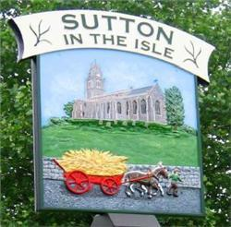
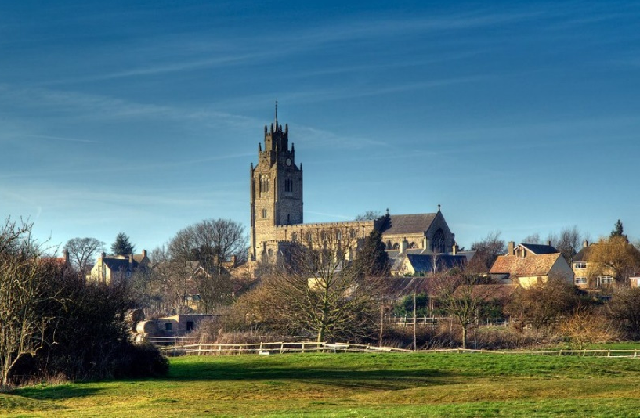
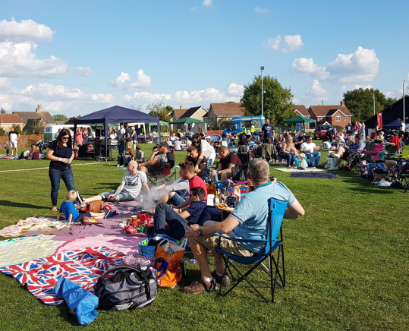
Sutton – our village and our community Sutton in the Isle is a village of around 1,000 households on the edge of the Fens, just seven miles from the historic city of Ely. For many years the village was mainly an agricultural area but in recent times it has grown, with exciting plans for further growth within and around the village. The village has a large church dating from the 14th century, which plays a central role in the village community, hosting regular events including beer festivals, markets, and concerts. As well as regular collective worship and family Songs of Praise events in the church, children from the school take part in the village concert which is held in the church annually. The many clubs and societies active in our village include a Conservation Society, WI, Cricket Club, needlework groups, football teams, Garden Club, Bowls, youth groups, and a community café. The Sutton Feast committee organise events throughout the year, including an annual ‘Picnic in the Park’, ‘Gault Day’, and an enormously-popular 10km race and fun-runs. The parish council own and run the beautiful old Glebe hall, as well as a modern Multi-Use Games Area, sports fields and pavilion. There is a village playing field on the outskirts of the village, and Sutton cricket club has a field nearby. There is a childrens’ play ground near to the school, and the village’s Childrens’ Centre is adjacent to the school. Like most large villages, Sutton's amenities include a doctor's surgery, convenience store, pharmacy, hairdressers, a car repair garage, pub and several eateries and take-aways. The mobile library visits the village once a week. The British Legion has a large hall and bowling green adjacent to the school, and provides parking for visitors to the school. There are two pre-school settings operating in the village. Both have close connections with the school and are invited to visit on many occasions during the year, including collective worship, and dress rehearsals for school performances. The pre-schools are also invited to use our field for sports activities.

Slide 10
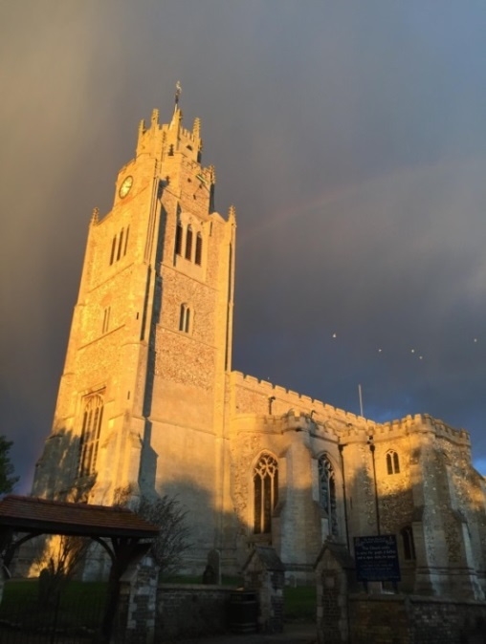
Our Christian Ethos The Christian ethos of the school is reflected in the behaviour of the whole school community and the respect with which they treat each other. Christian values are an integral part of the golden rules displayed in every classroom. Daily collective worship has a Christian basis as well as incorporating other aspects of school life. The school has recently introduced a new RE curriculum as recommended by the Diocese of Ely. From the incumbent of St Andrew’s Church, Sutton (Rev’d Mary Hancock) As the vicar of St Andrew’s Church, I am an ex officio Foundation Governor of Sutton Church of England (Voluntary Controlled) Primary School. I am also an ex officio governor of Mepal & Witcham Church of England Primary School (an academy in the Diocese of Ely Multi Academy Trust) in the nearby village of Mepal. In addition to serving as a governor, my roles in the life of Sutton School are to lead collective worship (currently about once a month), to welcome and host school services in St Andrew’s, to support work with classes as needed on subjects in RE and related areas, to work with the Headteacher on worship and the Christian ethos and values of the school and to provide pastoral support as needed to children and staff. The congregation of St Andrew’s frequently pray for the life and people of Sutton Primary School and look forward to welcoming the new Headteacher and a new phase in the life of this school which is so much part of our village. Our Church St. Andrew’s Church stands in a prominent position at the east end of the village. It was founded in the 14th century and has had many alteration and additions over the ensuing years. We have a regular congregation and a large choir – most of the children in the choir are pupils at our school where the junior choirleader teaches music. Two members of the congregation are also foundation governors at the school and visit the school regularly. Ethos statement for church schools in the Diocese of Ely Recognising its historic foundation, the school aims to serve its community by providing an education of the highest quality within the context of Christian belief and practice. It encourages an understanding of the meaning and significance of faith and promotes Christian values through the experience it offers to all its pupils.

Slide 11
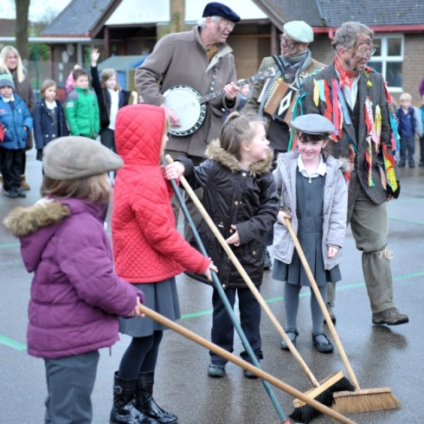
The Cambridgeshire Context Cambridgeshire is the fastest growing county in the country and one of the main economic drivers for the UK. The 0-19 population of Cambridgeshire is expected to increase by 18.5% between 2016 and 2036, although not evenly across the county. Cambridge City is expected to grow by 12.3% over this period, while South Cambridgeshire is facing an increase of 29.4%. There are around 137,800 children and young people under the age of 18 years living in the county, which represents 21% of the total population. The level of free school meals is lower than the national average. Nationally 14.5% of primary pupils and 13.2% of secondary pupils are eligible; across Cambridgeshire the levels are 9.8% and 8.3% respectively. Children and young people of school age from minority ethnic groups account for 12.2% of primary pupils and 9.4% of secondary pupils, compared with 31.4% and 27.9% respectively for the country as a whole. Locally, the largest minority ethnic group is Asian (3.8% of school-aged children). Travellers of Gypsy Roma and Irish heritage account for 0.7% of the school age population compared with a national average of 0.4%. Cambridgeshire is a relatively prosperous county. Our children generally have above average health, educational attainment and life chances. However there are pockets within the county where deprivation levels exceed or equal the national average, particularly in parts of Wisbech, Huntingdon North and the north east of Cambridge City. A particular feature of Cambridgeshire is that deprivation is spread widely across the county. 65% of children living in low income families live in our more affluent areas. Cambridgeshire County Council's Equality Pledge “We believe in the dignity of all people and their right to respect and equality of opportunity. We value the strength that comes with difference and the positive contribution that diversity brings to our community. Our aspiration is for Cambridge and the wider region to be safe, welcoming and inclusive.” Cambridgeshire County Council's Equality Objectives - Promote equality and inclusion with our workforce - Support employee and Member support networks - Improve the diversity of our workforce to reflect the communities we serve - Promote and celebrate diversity across the Council - Raise the profile of equality and diversity through communications campaigns
A visit from the Molly Men - a local Fen tradition

Slide 12
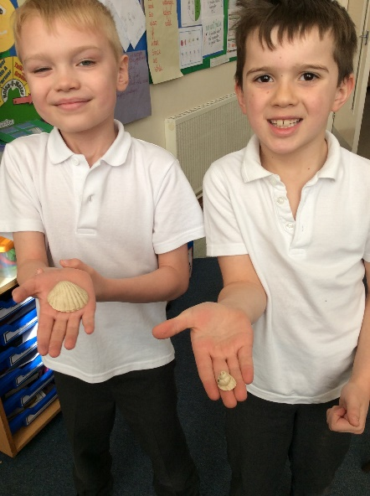
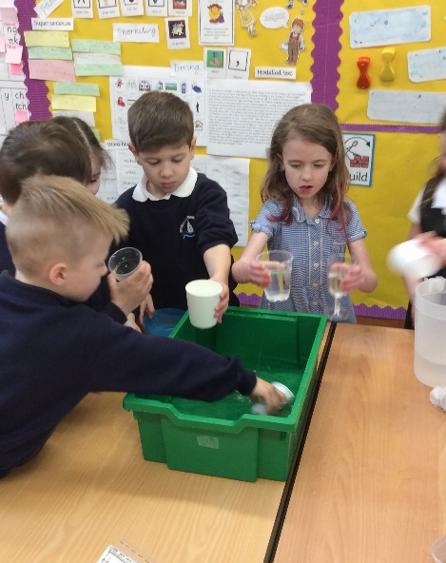
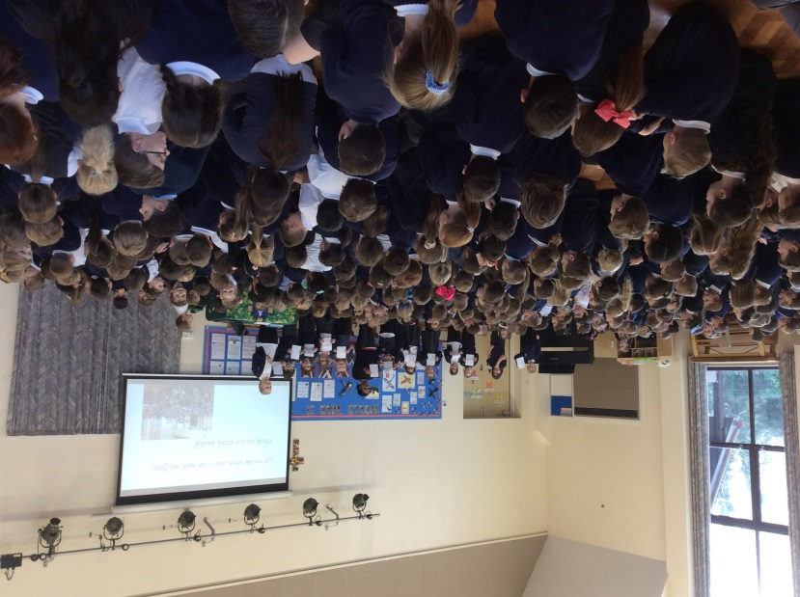
Pupil Voices We asked our pupils for qualities and strengths they would like to see in our new Headteacher: Kind & Helpful Trustworthy Firm but fair Supportive to all the children Enthusiastic Someone who does what they say they will do Know how to keep order Good fun! Challenge us but don't push us too far Dress Smartly Staff Voices When we asked our staff for input, there were recurrent strong themes around what they think we need in our new Headteacher: Someone who is interested in the child as well as the results – with a real interest in the well being of staff and pupils, and the wider school community. Staff need to feel supported, trusted & empowered to make decisions. They want someone who can get the balance right between driving the school forward as well as accounting for staff well-being. Children need a head teacher who is a visible presence, who they are comfortable to approach and is positive & engaging. Approachable and visible to parents. A proven leader, capable of taking tough decisions that not everyone will like. A great communicator with colleagues, pupils and the wider community. Someone who listens, seeking opinions and solutions from their team. On the pulse with school needs, but outward looking to new ideas. Enthusiastic about spiritual learning as a vibrant and inspirational element of school life.

Slide 13
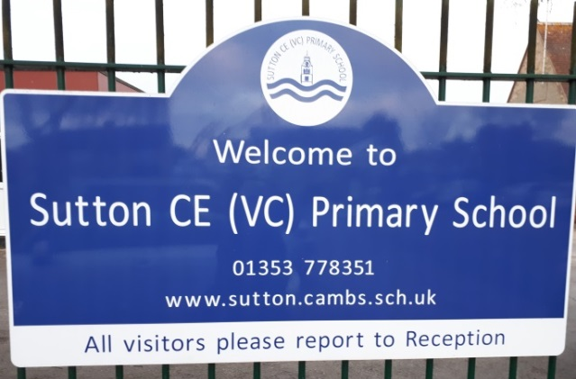
The Application and Selection Process You are very welcome to visit our school; please note that any such informal visit is not part of the selection process, and whether or not applicants have visited will not influence the final outcome. Please make arrangements through the School, either by telephoning the school office: 01353 778351 or by emailing office@sutton.cambs.sch.uk. If you have any questions about the school, please contact the Chair of Governors, Hilary Sanderson, by emailing Chair@sutton.cambs.sch.uk This is currently a Group 2 school and the salary will be within the ISR range L18-L24 (£63,508- £73,559). This is a permanent, full-time position to start in September 2021 or after Easter 2021 if available. The key dates for the selection and recruitment process are: • Closing date for applications midday Monday 25th January 2021. • Short Listing Friday 29 January 2021. • Two-day Assessment & Interview Thursday 4th and Friday 5th February 2021. Please submit your application using the form provided and a supporting letter (but please do not enclose a CV). Your supporting letter, of no more than 1000 words, should tell us how you satisfy the person specification, and how you would help us to achieve our vision at Sutton Church of England (VC) Primary School. Please return your letter and completed application form no later than midday on Monday 25th January to: headship@epm.co.uk EPM can be contacted on 01480 431992 or via headship@epm.co.uk Sutton Church of England Primary School is committed to safeguarding and promoting the welfare of children and requires all staff and volunteers to demonstrate this commitment. Offers of employment are subject to a satisfactory enhanced DBS disclosure and other employment checks.

Slide 14
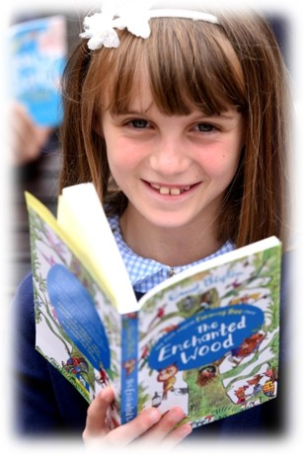
Job Description Contract: Full-time, permanent Grade: Leadership scale, range L14-L21 Post: Headteacher Sutton C of E (VC) Primary School Responsible to: The Governing Body of Sutton C of E (VC) Primary School Responsible for: All staff and pupils within the school Purpose of the Job: The Headteacher of Sutton Church of England (VC) Primary School will ensure that the school’s aims are implemented in accordance with the School Improvement Plan and other strategic plans and the policies of the Governing Body. The Headteacher is required to monitor, evaluate and review the impact of policies, priorities and objectives for improvement and take timely and effective action that results in sustained development. The Headteacher must provide leadership and management of the school and promote a secure foundation from which to achieve the highest possible standards in all areas of the work of the school. The Headteacher will carry out his/her professional duties in accordance with and subject to the National Conditions of Employment for Headteachers and relevant education and employment legislation. The Headteacher will endeavour at all times to meet the Department for Education’s National Standards of Excellence for Headteachers, 2015. Core responsibilities 1. To provide high-quality professional leadership and management for the school, securing high standards of achievement in all areas of school operation. 2. To manage teaching and learning as the school’s lead professional, such that personalised learning opportunities allow pupils to maximise progress and realise their full potential. 3. To create a safe and productive learning environment which engages and fulfils children, stimulates and inspires staff and secures the support of parents, carers and the local community. 4. To be accountable to the governing body and to work with governors to provide vision and strategic direction. 5. To evaluate methodically and analytically all aspects of school performance to: identify priorities for continuous improvement; raise standards; develop policies and practices; maximise use of resources.

Slide 15
Job Description continued Core responsibilities continued 6. To secure the commitment of the wider community to the school by developing and maintaining excellent and effective partnerships with: St Andrew’s church; other schools within the WASP partnership; children’s agencies; local authority personnel; local community groups. 7. To promote equality of opportunity, individuality, respecting diversity, eliminating unlawful discrimination and promoting Fundamental British values. 8. To lead and manage the school as a Church School effectively ensuring the promotion of Christian values and the distinctiveness that this entails. Further Description of Core Responsibilities Shaping the Future The Headteacher will work with the Governing Body to create a shared vision and strategic plan which inspires and motivates pupils, staff and others in the school community. Specifically, the Headteacher will: - Have a strategic view of how to develop and improve the school - Develop and monitor the School Improvement Plan successfully - Inspire, challenge and motivate others to take forward the strategic plan - Support staff development by offering a range of opportunities for CPD - Develop and foster links to work positively with relevant agencies to promote the school and foster the wellbeing and achievement of pupils and staff - Advise the Governors on key educational changes that may affect the school. Learning and Teaching The Headteacher will be responsible for ensuring high standards of teaching and learning to ensure that every child can reach their full potential including: - Demonstrating personal commitment and enthusiasm for the learning process, including teaching as necessary and appropriate, leading assemblies and providing a model of the standards expected of all staff within the school - Ensure a consistent and continuous school-wide focus on pupils’ achievement, using data and benchmarks to monitor progress and attainment in all children’s learning - Celebrate success in all aspects of school life and ensure that an atmosphere is created where every child can succeed and achieve through high quality and personalised learning experiences - Implement strategies which encourage high standards of behaviour, attendance and pupil welfare - Oversee the curriculum and foster outstanding working practices, encouraging debate and new learning amongst teaching and support staff.

Slide 16
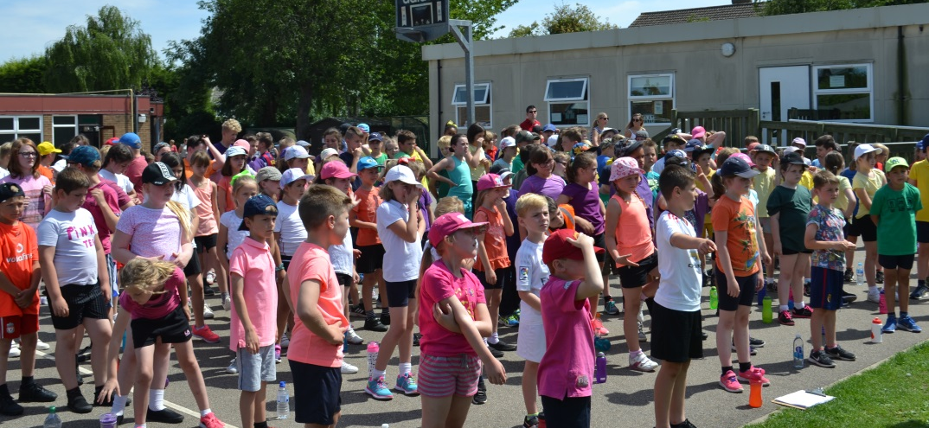
Job Description continued Leading and Managing Staff In order to develop effective relationships and communication which underpin a professional learning community, enabling everyone in the school to achieve, the Headteacher will: - Ensure that outstanding teaching is the primary objective for all classroom staff - Lead, motivate, support, challenge and develop staff so that they can reach their full potential - Recruit, retain and deploy high quality staff appropriately to achieve the vision and goals of the school - Manage staff performance effectively - Ensure that all staff are engaged with the school’s strategic priorities, and the development of the school’s aims and objectives, through effective communication across the whole school community - Acknowledge the responsibilities and celebrate the achievement of individuals and teams. Managing the School, Staff and Resources The Headteacher will provide effective organisation and management of the school including: - Ensuring that pupil safety is at the centre of all the school’s activities, particularly during the COVID-19 pandemic. - Assuming overall responsibilities for the day to day management of the school and efficient and appropriate delegation of duties - Prioritising, planning and organising themselves and others effectively and efficiently - Agreeing and setting appropriate priorities for expenditure with the Governing Body, allocating funds and monitoring the effective administration and control of school budgets so that the school secures its objectives - Deploying and managing the school’s financial and human resources efficiently and effectively to achieve the school’s educational goals and priorities - Ensuring school buildings and facilities meet the needs of pupils and staff, and are of the highest standard of cleanliness and repair, and compliant with health and safety regulations - Exploring and developing additional sources of funding.

Slide 17
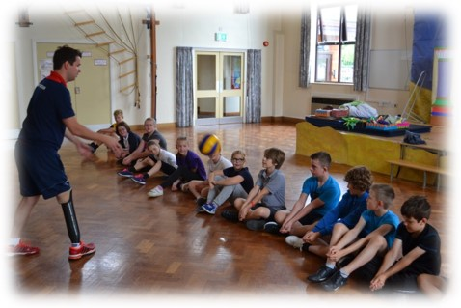
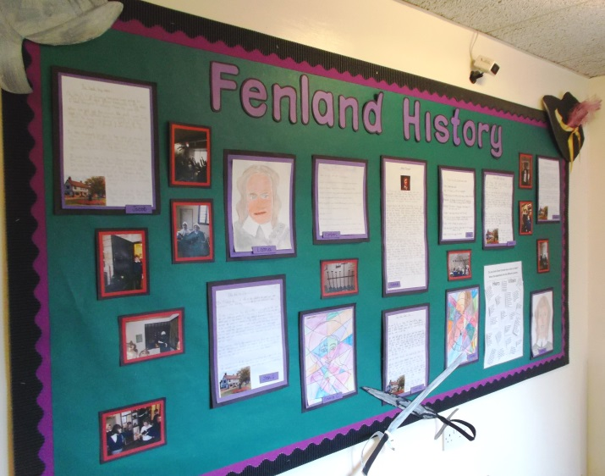
Job Description continued Stakeholders and the Local Community The Headteacher will engage with the local and wider community including: - Promoting and developing the school’s reputation and acting as an ambassador for the school in a manner which upholds its values and ethos - Securing the commitment of parents, carers and the wider community in the vision and development of the school to enhance the education of all pupils - Contributing to the development of education by sharing good practice, contributing to new initiatives, utilising current research and working in partnership with WASP - Continuing to build relationships with St Andrew’s church, the Diocese of Ely and the local community to enhance the learning opportunities for the school. Accountability and Governance The Headteacher will be legally and contractually accountable for the school, its environment and all its work, and will: - Present a coherent and accurate account of the school’s performance in a form appropriate to a range of audiences, including the school governors, parents, the local authority, the local community and OFSTED - Work with the Governing Body to plan for future needs and the further development of the school - Ensure that all legal requirements, including Safeguarding, Child Protection and Health and Safety are fulfilled with effective systems in place - Translate the vision into a plan with agreed, prioritised objectives and operational plans which will promote and sustain school improvement within an agreed timeframe, measuring and reporting on the school’s success in meeting the action points of such plans - Encourage a school ethos which enables everyone to work together, share knowledge and understanding, celebrate success, and accept responsibility for outcomes.

Slide 18
Person Specification Please address the person specification when completing your application, stating how you fulfil the criteria below, describing the impact that has resulted from your work to date in current and previous relevant posts. You do not need to repeat information that is on the application form in your supporting statement. We are seeking to appoint a head with vision, strong skills of leadership with an emphasis on team development and the highest standards of integrity and commitment. The successful candidate will be fully in tune with the ethos of a Church of England (VC) school serving the village community, that strives to offer a broad and exciting curriculum. He or she must care passionately about the education in the widest sense of pupils of all ages, and the welfare and development of staff. In the table below, we describe how we will evaluate items - via either: AF: application form; or, I: Assessment Tasks and Interview.
 | Essential | Desirable | Evaluated via
QUALIFICATIONS
Qualified Teacher Status | * |  | AF
Degree or equivalent | * |  | AF
National Professional Qualification for Headship (NPQH) |  | * | AF
Accredited school leadership and management training |  | * | AF
Designated Safeguarding Lead |  | * | AF
EXPERIENCE
Record of successful class teaching with at least 5 years’ experience in a primary school setting | * |  | AF
Current experience as an effective Headteacher, interim Headteacher, Deputy Head or in a leadership role where the school is rated Good or above | * |  | AF
Proven leadership skills, including leading strategic development | * |  | AF/I
Evidence of building positive working relationships with staff, parents, governors and others | * |  | AF/I
Experience of recruiting and retaining outstanding staff, with an understanding of HR issues and processes |  | * | AF
Experience of managing change effectively | * |  | AF/I
Evidence of a strong track record of implementing and managing the delivery of sustained improvement in curriculum and pupil achievement, using relevant data | * |  | AF/I
Evidence of engaging with parents so they understand their child’s attainment and what they can contribute to help their child succeed | * |  | AF/I

Slide 19
This governing body and Cambridgeshire County Council are committed to safeguarding and promoting the welfare of children and young people. Headteachers must ensure that the highest priority is given to following guidance and regulations to safeguard children and young people. the successful candidate will be required to undergo an enhanced check from the Disclosure and Barring Service.
PROFESSIONAL SKILLS AND KNOWLEDGE
Commitment to the school’s distinctive Christian vision, to support and promote the ethos and values of a Church of England School | * |  | AF/I
Ability to lead by example, demonstrating vision and inspiration in leading the future direction of the school | * |  | AF/I
Up to date knowledge and understanding of child welfare and safeguarding | * |  | AF/I
Ability to articulate a clear vision for the school and its development over the next three years | * |  | I
Ability to organize and manage work efficiently, prioritise and manage tasks, delegating appropriately | * |  | AF/I
Ability to manage and develop a site that ensures the health and safety of staff and pupils | * |  | AF/I
In-depth understanding of National Curriculum and ability to develop effective and creative responses to complex curriculum issues | * |  | AF/I
Demand ambitious standards for all pupils, overcoming disadvantage and advancing equality, maintaining a strong sense of accountability in staff for the impact of their work on pupils’ outcomes | * |  | AF/I
Ability to encourage, motivate and nurture others | * |  | AF/I
Experience of recruiting, managing and developing staff | * |  | AF/I
Hold all staff to account for their professional conduct and practice; able to inspire all staff to attain outstanding practice, nurture and consolidate good teaching, and ensure weak practice is identified and eliminated, and good or better practice is shared | * |  | AF/I
Ability to work in partnership with local schools and services to champion best practice |  | * | AF/I
Ability to make astute financial decisions, through a clear understanding and knowledge of budget management |  | * | AF/I
PERSONAL QUALITIES
Able to motivate and inspire pupils and staff | * |  | AF/I
An agile and positive attitude to changing priorities and demands | * |  | AF/I
A good communicator and listener, written and oral, at all levels | * |  | AF/I
Integrity, commitment, enthusiasm and resilience, enabling perseverance and success | * |  | AF/I
Capacity for and commitment to personal development, a reflective practitioner who is open to advice | * |  | AF/I

