Slide 1
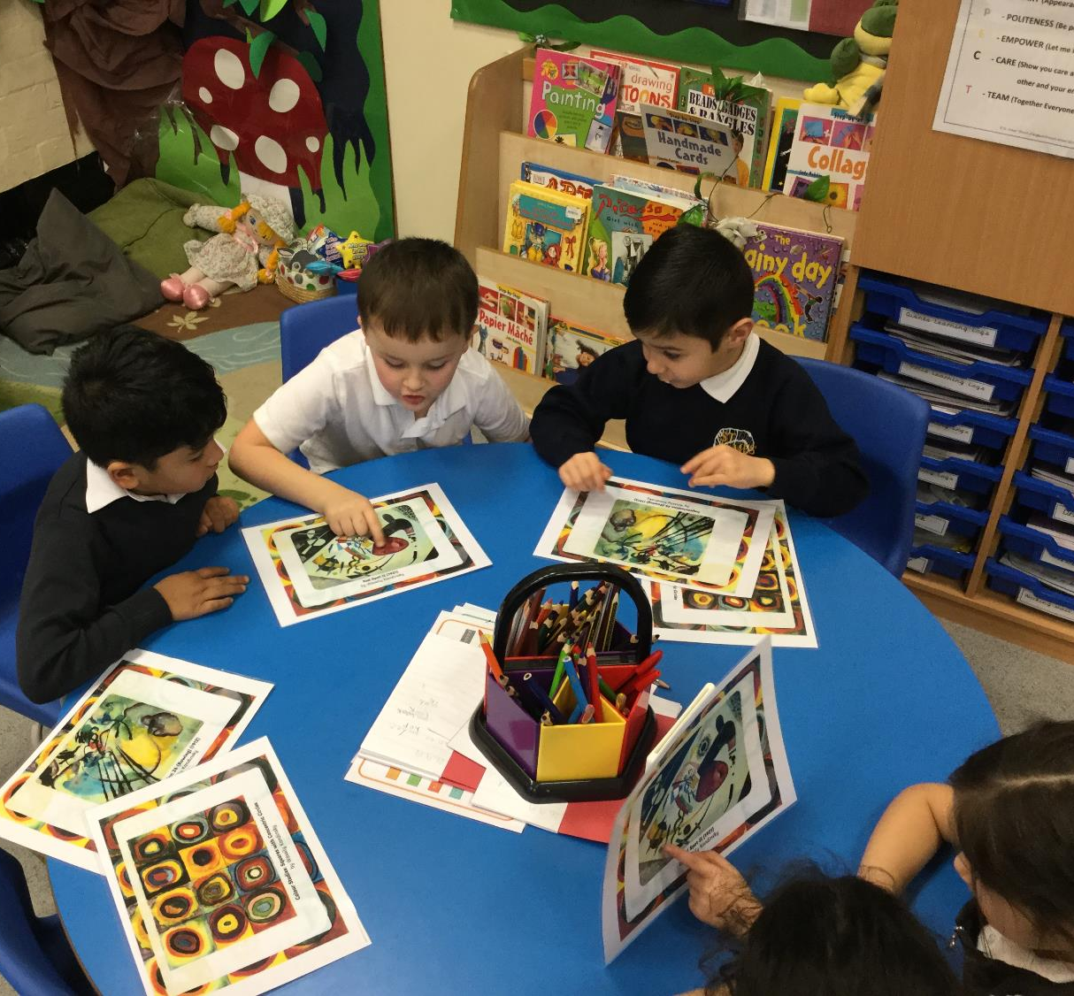
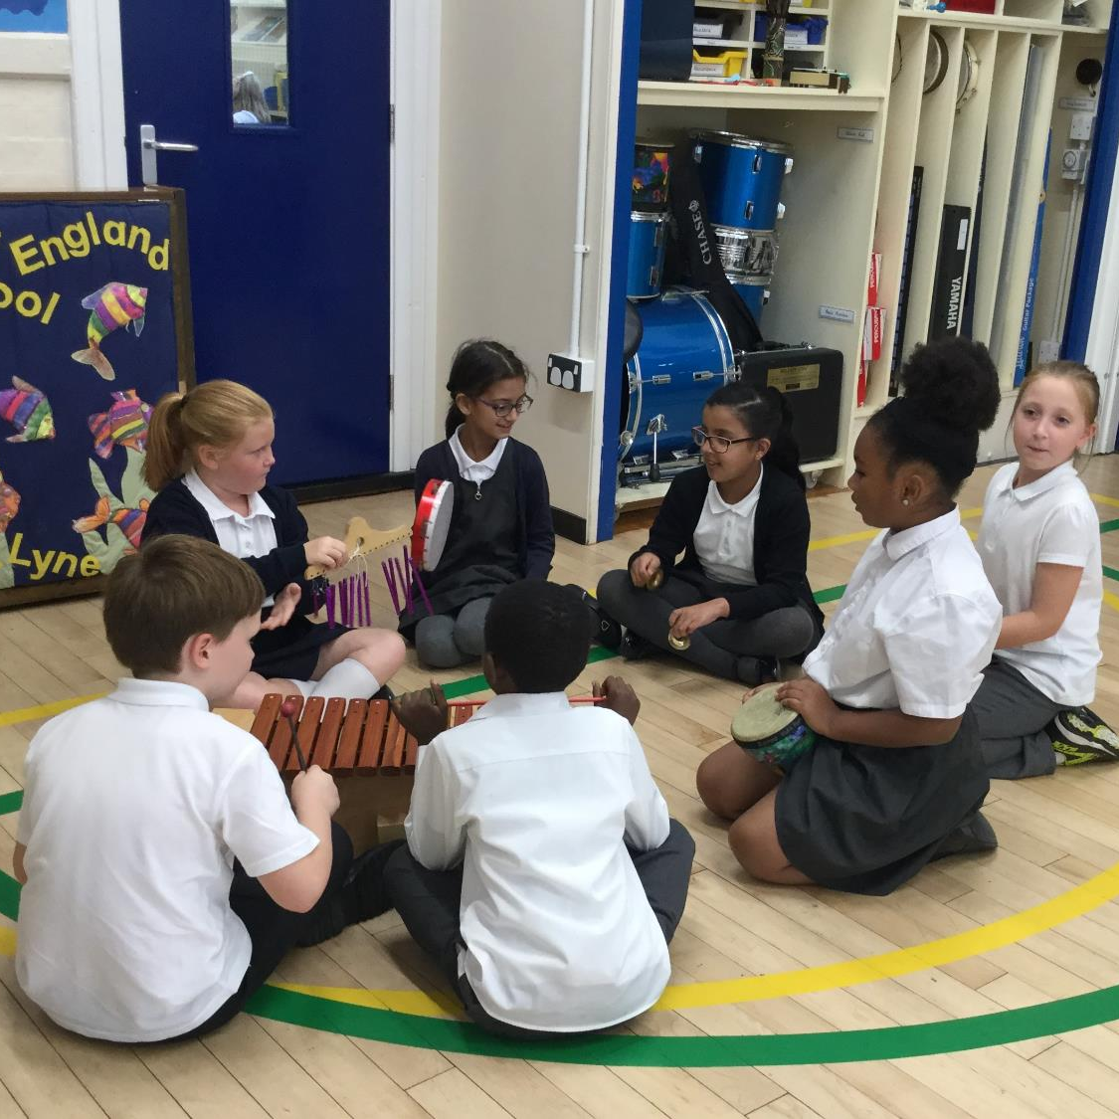
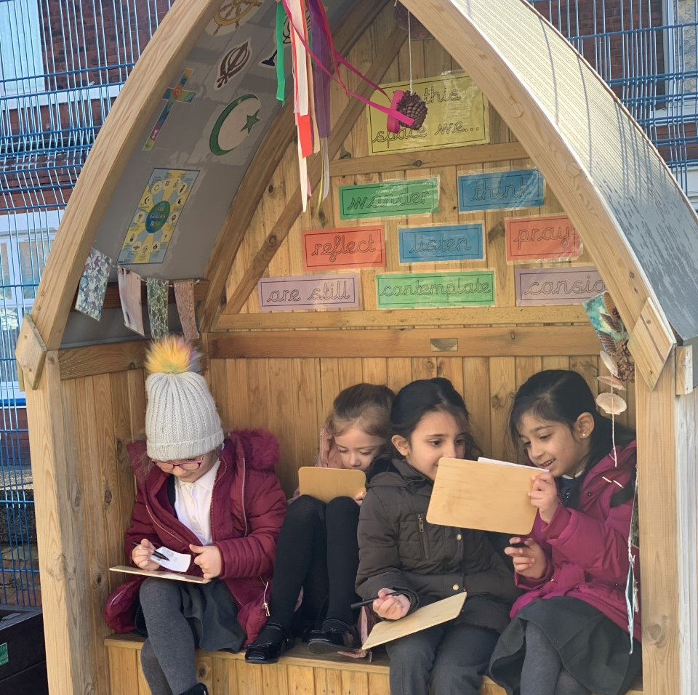
A warm welcome to St James’ Church of England Primary School Part of the Forward As One Church of England Multi Academy Trust

Slide 2
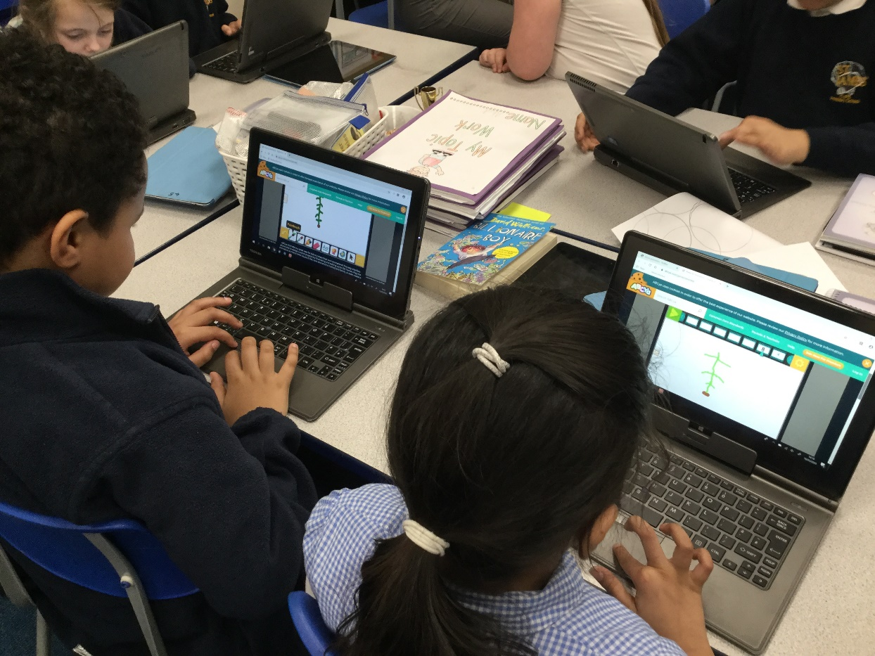
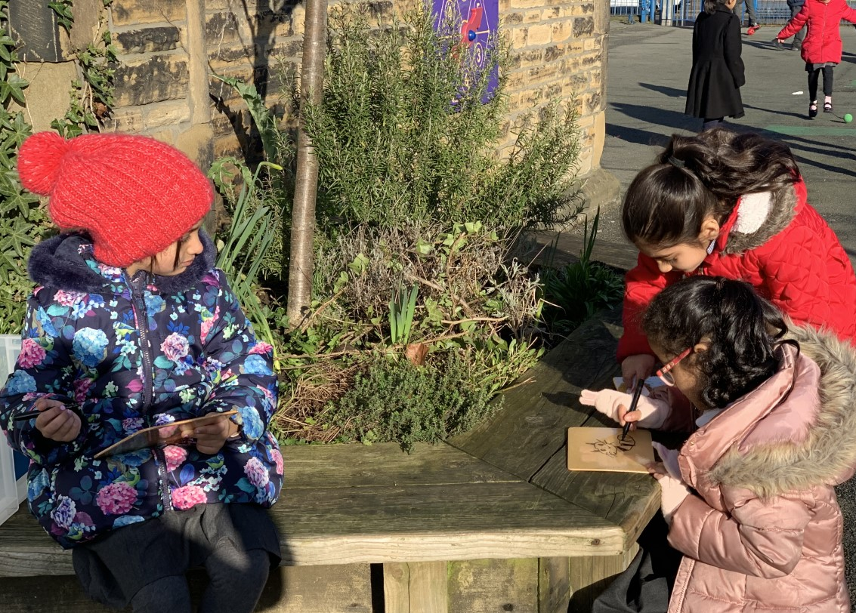
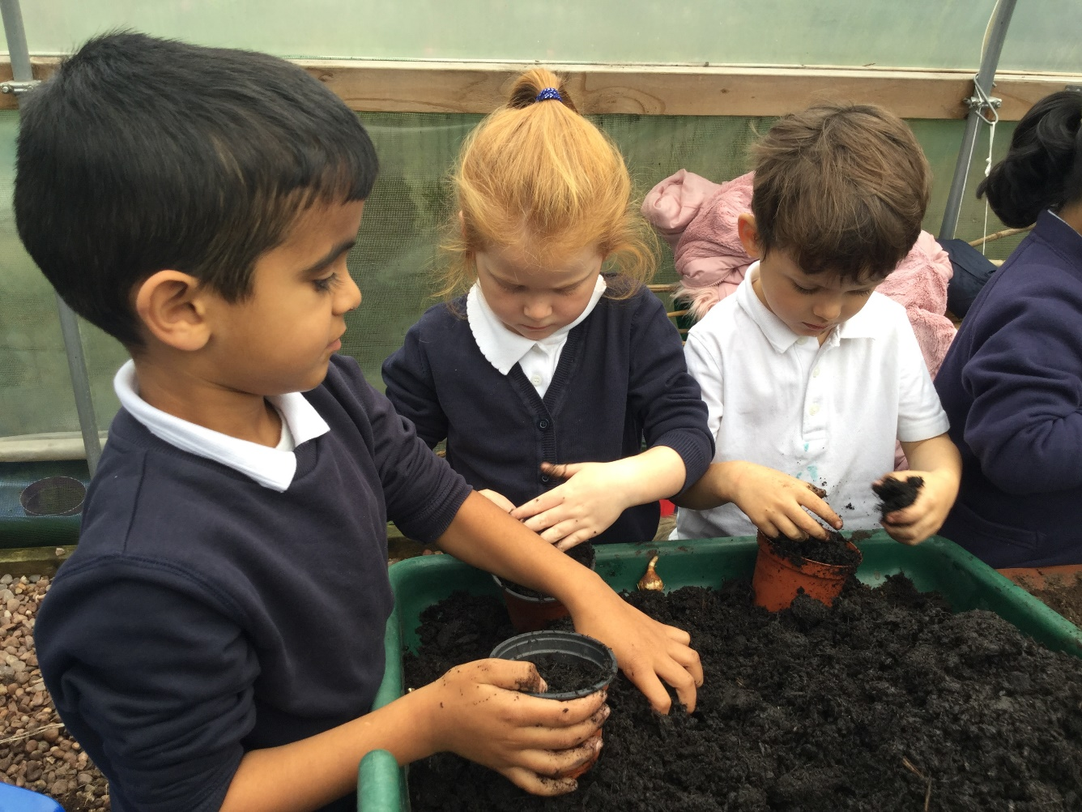
About St James’ Church of England Primary School
Welcome to St James’ Church of England Primary School. Thank you for your interest in applying to be the new Headteacher.
We are a one-form entry, Church of England primary school for children 4-11 years old in the Parish of The Good Shepherd, Ashton-under-Lyne. We are proud to be part of the Forward As One Multi Academy Trust. Our most recent Ofsted judgement is ‘Good’.

Slide 3
Our Values
Together in Faith, We Are a Winning Team
.
As a Church of England Primary School, rooted in a Christian tradition, we believe that academic success and personal wellbeing are equal partners.
Our mission is to develop a happy community with enquiring minds, a spirit of curiosity and a love of learning where there is respect for self, others and the environment. We want every member of our team to have the skills, confidence, resilience and adaptability to thrive in a rapidly changing world.
Our school serves a vibrant and diverse community and each individual brings with them their own unique qualities. By putting our inclusive Christian values and ethos into practice, we aim to empower our whole community to grow spiritually, academically and morally to build a better world for the future. We are stronger together.
“ For just as each of us has one body with many members, and these members do not all have the same function, so in Christ we, though many, form one body, and each member belongs to all the others.” Romans 12: 3-5

Slide 4
Our Values
Together in Faith, We Are a Winning Team
.
Each and every day, we put our faith into action through our Golden Values. These values underpin everything that we do. They are our code of conduct.

Slide 5
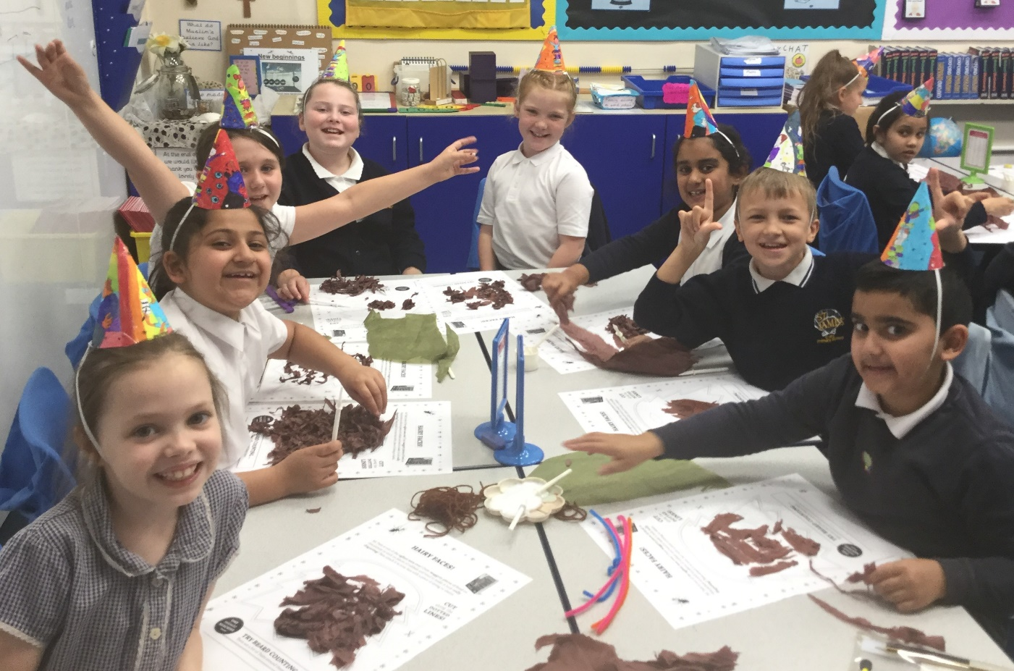
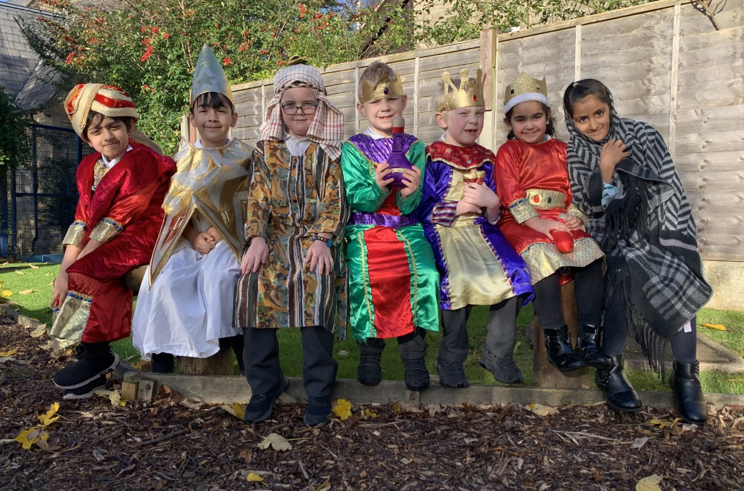
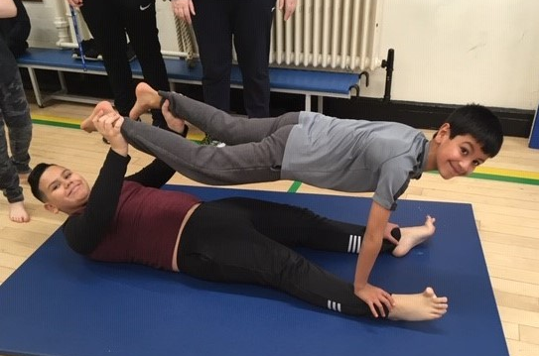
Our Children
.
We encourage our children to be confident individuals who strive to be the best that they can be. They surprise and inspire us every day.
Children from Class 6 have produced a film to tell us what kind of Headteacher they need.
https://www.st-james-ash.tameside.sch.uk/community

Slide 6
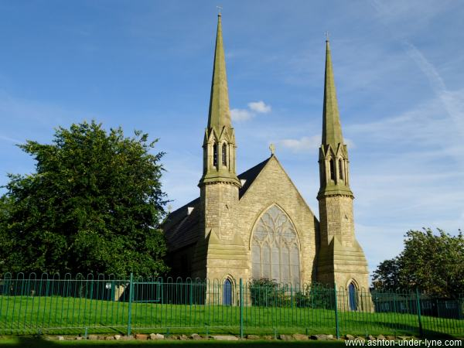
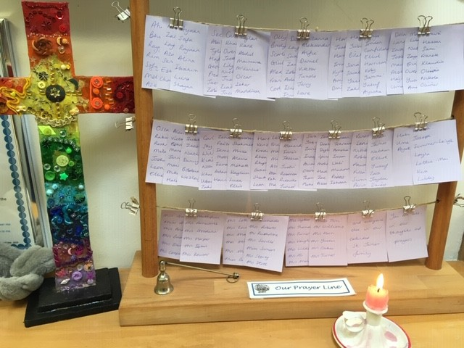
Our Parish
.
The Parish of the Good Shepherd is situated in Central Ashton-Under-Lyne. There are 5 churches within the parish. The churches are all different but we share a desire to make the love of God known in the world and to see God’s kingdom come in Ashton-under-Lyne.
The parish has a population of 19,000 people with a wide cross section of age, gender, ethnicity and social groups. A significant proportion of the parish sits within an area of high urban deprivation. Active local partnerships, regeneration initiatives and charities work for the good of the community and there is a healthy network of strong local community groups.
Rev. Roger Farnworth has been Church of England Minister at St. James’ Church since 2003.

Slide 7
A letter from our Chair of Governors
.
Dear Applicant,
Thank you for your interest in applying for the post of Headteacher at St James’ Church of England School in Ashton-under-Lyne, part of the Forward As One Academy Trust. We are a friendly, caring and aspirational school, with a strong Christian foundation, committed to academic success, with personal development and wellbeing as equal partners.
Our school and church are part of a rich and diverse community and we are proud of the strong and effective relationships that exist with our families and partner agencies. We are totally committed to the education of the whole child and our children enjoy a broad and balanced curriculum that as well as the academic subjects sees sport, the Arts, gardening, cooking, forest schools as integral building blocks and experiences in the education of our children.
This is an exciting time to be joining St James’, as we move forward in our journey to becoming an outstanding school. I hope that the enclosed information will give you a good picture of the school and of the person that we are looking for in our next Headteacher.
Yours faithfully,
Shelagh Walton
Chair of Governors

Slide 8
A message from our CEO
.
We look forward to welcoming the new Headteacher of St James’ CE Primary school to our ‘One Team’ of Forward As One CE MAT.
At Forward As one, we believe that all of our schools should meet and serve the needs of the communities in which they sit. This means that, whilst we collaborate and work very closely together across the Trust, we do not expect our schools to be identical.
St James’ is a creative, nurturing school. It is based in two buildings and has the added luxury of incorporating a Sure Start building on one of them. The school is very proud of their gardens, (including 2 poly tunnels) in which they learn how to grow an array of vegetables which they then learn how to cook. Both grounds and gardens are a wonderful resource for the school to utilise.
As Headteacher of St James’, the successful candidate will also be an integral part of the leadership team of Forward As One. Our Headteachers work together for the collective benefit of all schools and children in the Trust, sharing their skills and expertise for the benefit of all – moving Forward together as One. We are excited to welcome a new member to our talented team.
Karen Bramwell
Chief Executive Officer
Forward As one CE Multi Academy Trust.

Slide 9
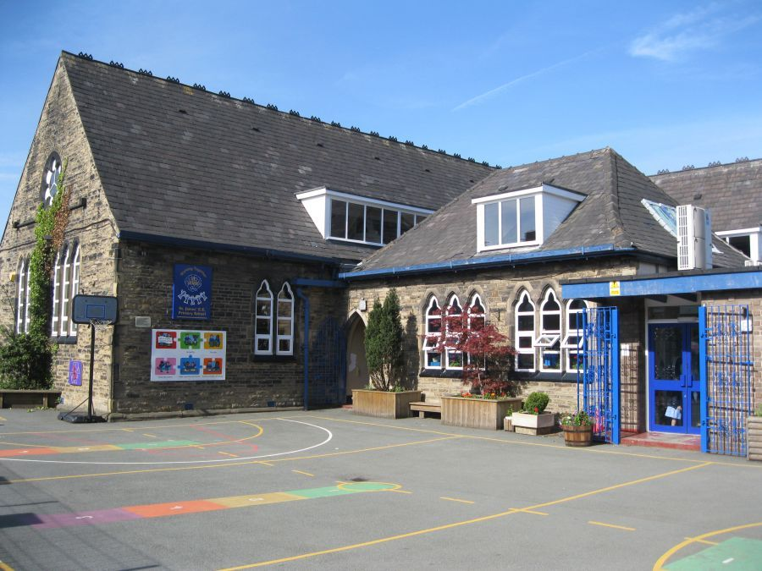
Visits to the school are actively encouraged on the following date:
Monday 29th March: 2pm and 4pm
Closing date: 9am Monday 19th April 2021
Interviews: Friday 30th April 2021
Please return your application to: millsj@spsd.fa1.uk
For more information, visit:
www.st-james-ash.tameside.sch.uk
www.forwardasone.uk
@StJCEPrimary
@ForwardAs1Trust

