Slide 1
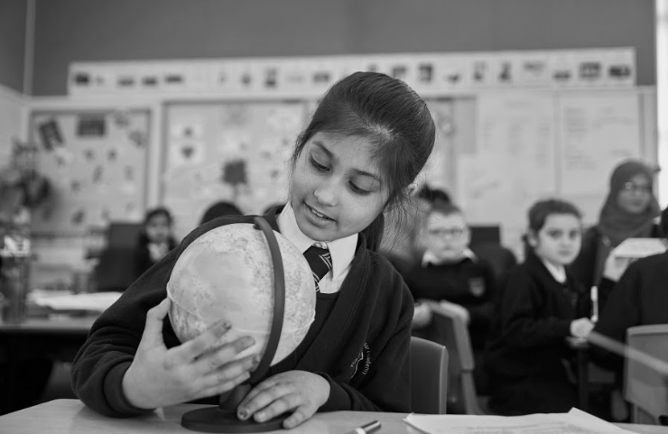
Class Teacher
Recruitment Pack

Slide 2
WELCOME TO
GODOLPHIN JUNIOR ACADEMY
Dear Applicant,
Thank you for your interest in a role at Godolphin Junior Academy. I hope you find this information pack a useful introduction to our school.
Godolphin Junior Academy is a large, four-four entry junior school in Slough. Slough can be easily reached from the M40, M4and M25 and is only a twenty minute train journey from London Paddington.
Our aim is for all pupils to be successful. We believe in every child and we make sure that our ambitious curriculum is tailored so that every child can achieve their very best. We share the belief that our young people are capable of amazing things.
As a teacher in our school you will be valued, developed in your role and encouraged to be creative and imaginative. Pupils at Godolphin behave exceptionally well and have impeccable manners because they are taught well and relationships are strong. Our parents are incredibly supportive and they recognise that we are a team around their child.
The successful candidate will have drive and enthusiasm and will be committed to securing the highest academic standards for our pupils. They will be professional and will have excellent interpersonal skills. Outstanding teaching and learning is at the heart of our school development.
The deadline for applications is 12pm on Monday 10th May 2021. Shortlisting will be the same day. For more information about the Academy, please visit our website. If you have any questions or wish to discuss the role, please contact Office Manager Claudia Balague on 01753 521 481 or email gjaoffice@theparkfederation.org
We wish you the best of luck with your application and look forward to meeting you.
Yours faithfully,
Helen Abell, Principal, Godolphin Junior Academy

Slide 3
EXPECTATIONS AT GJA
BEHAVIOUR AND ATTITUDES
At Godolphin Junior Academy we believe that children should be taught how to socially interact, how to use manners and how to make the right choices by explicitly teaching these skills. We do this through an approach called R Time.
R Time is an exciting, dynamic, fun-filled Personal and Social Education Programme. The emphasis is upon creating effective, respectful relationships by way of random pair work. R time has been shown to improve behaviour, reduce bullying, raise self-esteem and accelerate learning.
THE GODOLPHIN JUNIOR ACADEMY SCHOOL RULES
WE SHOW RESPECT AND GOOD MANNERS AT ALL TIMES WE CARE FOR EVERYONE AND EVERYTHING
WE FOLLOW INSTUCTIONS WITH THOUGHT AND CARE
These are three diamond rules at our school which we believe everybody, including staff, parents and visitors, should abide by. These rules are used more as values and life skills which we teach our pupils and embed throughout the curriculum. These values are key to making our school the caring and welcoming school that it is.

Slide 4
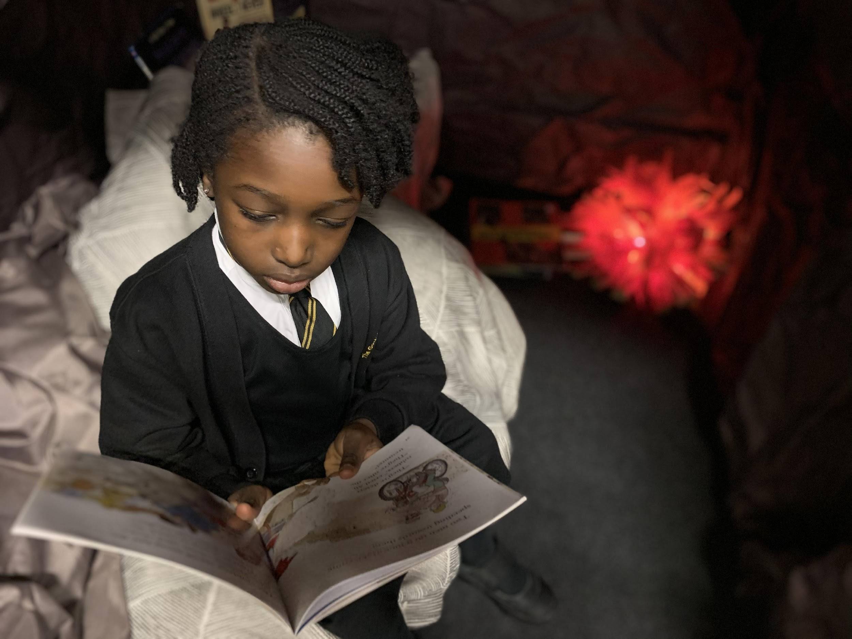
THE GJA CURRICULUM
A TEXT-BASED CURRICULUM
At Godolphin Junior Academy, we enable each and every child to explore, understand and appreciate the world around them by engaging them in high-quality literature from different times and places.
Reading is at the very heart of our curriculum and our carefully selected class texts open the opportunities for children to travel the world, delve into historical past times, recognise the brilliance of scientists and explorers and analyse, question and compare political viewpoints.
Through literature, we open our children’s mind’s eye so that they can almost live the experiences that they read about. Our wider curriculum is carefully linked to each class text and interweaves themes, concepts and topics within subjects and across year groups. Through these carefully-planned connections our pupils are able to acquire key knowledge to learn, make progress and lead as fully rounded, confident citizens.

Slide 5
SCHOOL INFORMATION
FACTS AND FIGURES
TYPE OF SCHOOL: Junior
AGE RANGE: 7 - 11
DENOMINATION: None
AVERAGE CLASS SIZE: 30
NURSERY: No
LOCATION: Slough
455
PUPILS ON ROLL
NQT
22 FTE teaching staff
1 Newly Qualified Teacher
EAL
81%
SEN
7%
PP
32%

Slide 6
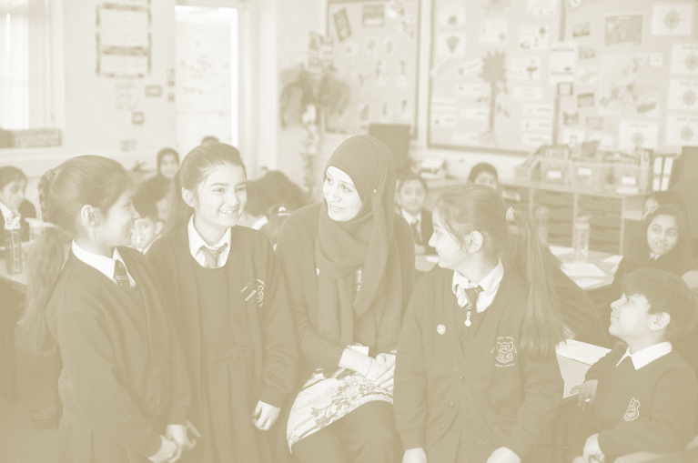
WHAT STAFF WHO JOINED GJA HAVE TO SAY
I joined Godolphin Junior Academy as a Vice Principal and it was the best decision of my career. This school is like no other. From the moment I stepped in the doors, it was clear that this school was warm and welcoming. All staff members are kind, caring and supportive. They are always there to lend a hand and guide you when necessary. Above all, the children are welcoming and a true delight. With wonderful behaviour and polite manners, you can spot a Godolphin pupil anywhere. The school offers tremendous opportunities for their children and everyone comes together to ensure it happens and to celebrate the successes. Godolphin is one of a kind and is somewhere you will be proud to work. A wonderful community.
- Miss Powell, Vice Principal
I joined Godolphin Junior Academy as the Assistant SENCO and EAL lead. From the moment I walked through the door I was immediately made to feel welcome. Friendly faces greeted me and I instantly felt a part of the team. Not only was I made to feel welcome by all the staff but the children were just as polite and enthusiastic in getting to know me. Pupils are respectful, resilient, hard working and eager to learn.
There is a strong work ethic and everyone is willing to go that extra mile for one another. I have been enhanced by various CPD opportunities, chances to learn from others and given chances to develop my skills by a supportive senior leadership team.
Godolphin offers both staff and pupils the chance to thrive. I am looking forward to personally continuing my journey at Godolphin
- Mr. Dallibar, Assistant SENCO and EAL Lead

Slide 7
WHY JOIN
Godolphin Junior Academy
Enthusiastic children who are excited about learning
A committed and supportive staff
A diverse, supportive and high need community where you can make a real difference
Holistic, challenging and supportive CPD
Practical London transport links
Excellent learning environment
Be part of a dedicated, progressive and enterprising leadership team
Opportunity to work alongside colleagues from seven partner schools within the Park Federation

Slide 8
WHY JOIN
THE PARK FEDERATION
As a member of staff within the Federation you will have access to number of key benefits including :
High quality CPD both at academy level and at Trust level with a range of bespoke in house training opportunities for all staff. In addition, the Trust is licensed to deliver the NPQML and NPQSL courses, which are run annually.
An employee support programme through the Education Support Partnership which offers wellbeing and counselling
A fully staffed, experienced Trust team who are there solely to support each academy with finance, HR, operations and premises
A commitment to collaboration across all eight schools with opportunities to share good practice and work together on shared projects and in cross federation teams
The Federation has a very clear vision:
The Park Federation is committed to children and families and as such invests in two very special projects.
The Childhood Promise
We believe that childhood is a very special gift that should be treated with the utmost care. As key adults in a child’s life, we need to respect this unique gift and ensure that it is as perfect as possible for each boy and girl. We think that every child, without exception, is entitled to a set of experiences that they can deposit in a bank of childhood memories to remember and savour for a lifetime. Experiences like: a walk in the woods, a paddle in the sea, a picnic in the countryside, an outing to the theatre, a river boat journey, a trip on a train or a sightseeing tour of London! Each school year the federation arranges and funds one of these special experiences for every child.
Global Park
The Federation’s own charity fundraising project. Through Action Aid, every year group in every school within the federation sponsors an individual child. In 2019 we are sponsoring 60 children as well as funding other worthwhile global charity work.
Join us in making our federation a springboard to success!
Dr. Martin Young
Chief Executive
The Number One School of Choice for Local Families
Our schools are safe, happy places where creativity is prized. We value and nurture excellent behaviour, determination and ambitious academic standards. Professionalism, humility and service to the community guide everything we do.

Slide 9
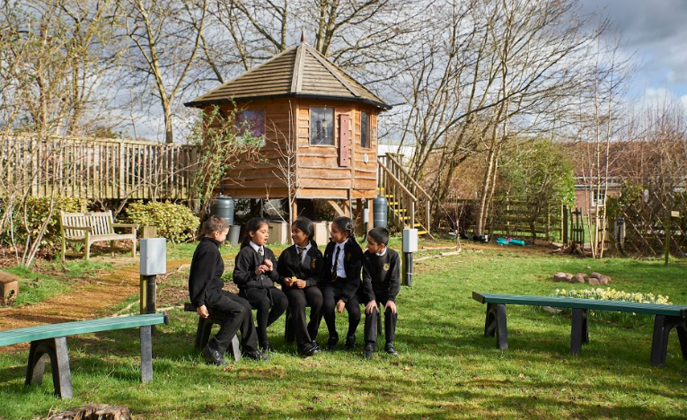
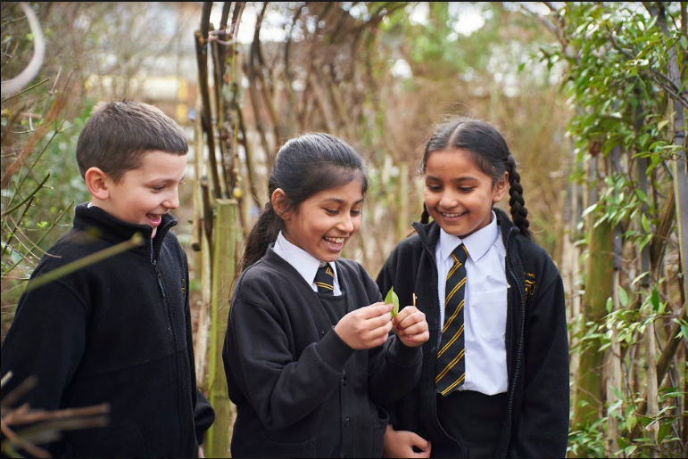
“Leaders have developed an interesting, engaging curriculum that immerses the children in their learning”
OFSTED 2019
“The school’s work to promote pupils’ personal development and welfare is outstanding.”
OFSTED 2019
Pupils have a good understanding of the school rules and what they mean, for example the importance of showing respect to one another and being polite.
OFSTED 2019

Slide 10
JOB DESCRIPTION Page 1 of 2
Main purpose of the job:
Teaching and Learning:
Teach a class of pupils and ensure that planning, preparation, assessment and reporting meet their varying learning and social needs
Be an excellent classroom practitioner with the ability to inspire, motivate and enthuse others
Have high expectations of learning, achievement and behaviour
Be able to work well as part of a team
Have high expectations of all pupils and inspire them to be lifelong learners
Provide pupils with positive and enriching learning experiences
Support and contribute to the school’s responsibility to safeguarding children
Be able to lead or support a subject area (depending on experience)
Support and implement the vision and ethos of the school
Be an effective role model in terms of teaching, behaviour and classroom management
Plan, implement and deliver an appropriate broad, balanced relevant and differentiated curriculum for pupils
Plan, implement and deliver cross curricular approaches to teaching and learning
Regularly assess, analyse and monitor pupil progress with any underperforming pupils targeted in future learning
Set clear targets, based on prior attainment for pupil’s learning
Ensure that records are maintained and shared appropriately
Provide a stimulating classroom environment, where resources can be accessed appropriately by all pupils
Identify clear learning objectives and content appropriate to the subject matter and the pupils being taught
Maintain good discipline amongst pupils in accordance with the school’s Behaviour Policy
Provide regular marking and feedback of pupil’s work and provide the pupils with their future improvements or next learning steps
Lead, organise and direct support staff within the classroom
Attend all relevant meetings and INSETs which relate to the school’s management, curriculum, administration or organisation
Communicate and co-operate with specialists from outside agencies

Slide 11
JOB DESCRIPTION Page 2 of 2
Responsibilities:
Actively promote the aims of the School through good practice and a constant professional attitude
Be an active and supportive member of the school staff through maintaining and contributing to the development of the core values of the school, setting and maintaining high expectations of standards of work.
Model behaviour that encourages a sense of responsibility and consideration for others
Maintain good order and discipline amongst pupils across the school
Develop and maintain good relationships, interaction and co-operating within school and between school and home
Communicate effectively with parents/carers of pupils and with persons or bodies who are concerned with the welfare of pupils
Participate in a positive way to the decision making processes within the school
Play a full part in the life of the school community and support the school ethos
Follow and actively promote the school’s policies
Understand and follow the Safeguarding Procedures listed in the school’s Child Protection Policy
Participate in the school Appraisal system for the appraisal of your own performance
Carry out any duties which may from time to time, be required by the Principal and/or the SLT

Slide 12
PERSON SPECIFICATION Page 1 of 2
 | Essential | Desirable
Qualifications | Qualified teacher status. Experience of Key Stage 2 curriculum. | Training relevant to Key Stage 2. Further qualifications and/or studies relevant to the primary age range First Aid Training. Knowledge and experience of personalised learning.
Experience | Teaching experience in Key Stage 2 with proven ability as a classroom practitioner. (If an NQT this would be successful student teacher experience). Ability to provide a stimulating and challenging classroom environment for all children. | Classroom experience in Key Stage 1. Experience of working with and supervising other adult support within the classroom. (Teaching assistants, parent helpers, students).
Specialist Knowledge | Knowledge and Understanding of a broad, balanced and relevant curriculum. A secure understanding of the processes by which children learn. Ability to differentiate the curriculum to meet the needs of all achievers. Competent in the use of ICT across the curriculum especially in the relation to the use of Whiteboard Technology. Understanding and use of assessment to inform future learning and teaching. Competent in the use of observational assessment to inform further learning. A willingness to work on one or more curriculum areas. The promotion of good behaviour through self-discipline. To be able to work creatively and sensitively with children. | A well-developed knowledge of a particular curriculum or specialist area. An understanding of a whole school approach to improvement and raising standards. Effective use of ICT to support planning and assessment. Familiarity with the SEN Code of Practice. Familiarity with the delivery of letters and sounds.

Slide 13
PERSON SPECIFICATION Page 2 of 2
 | Essential | Desirable
Personal Qualities | A caring ethos. A commitment to working cooperatively in a team situation. An enthusiastic, caring and flexible teacher. A commitment to quality learning. A commitment to the role of parents as co-educators. A creative thinker. Self-motivation and initiative. An ability to embrace change with enthusiasm and a positive outlook. A commitment to high standards To be able to accept and act on advice and support when necessary. Have an ability to work and plan with colleagues in a constructive manner. To be able to motivate children to achieve their best. | A sense of humour. An ability to inspire and motivate children. To be able to lead a subject area effectively. To be able to think strategically. To contribute eagerly to all aspects of school life.
Professional Development | A willingness to attend courses and training which further school development as well as personal goals. An ability to disseminate information to other staff and share expertise. | An understanding of current development in Primary education. To have an up to date knowledge of national priorities to support school improvement planning.

Slide 14
IMPORTANT DATES
Pay range | MPS/UPS
Leadership range | N/A
Start date | 1st September 2021
Closing date | Monday 10th May 2021
Shortlisting date | Monday 10th May 2021
Meet staff and governors | N/A
Interview dates | Thursday 13th May 2021
Visit the school | Visits to the school can be arranged via the office manager.
Visit the school website | www.thegodolphin-jun.academy
Visit the Park Federation website | www.theparkfederation.co.uk

