Slide 1



Isebrook: Consultation to expand provision
Isebrook School

Slide 2
Consultation
Isebrook Student Numbers
Present 200
Increase funding agreement to 252
(including 25 at Connected Provision)
Satellite Provision
Connected Provision

Slide 3







Slide 4

Vision and Values

Slide 5


Why are they important?

Slide 6






Slide 7
Confident Individuals
Responsible Citizens
Successful Learners

Slide 8
Confident Individuals
Impact
Implementation
Intent
Responsible Citizens
Successful Learners

Slide 9
Impact
Successful Learners
Confident Individuals
Responsible Citizens
Achieve
Now and in the Future
Personalised
Enable
Successful
Happy
Safe
Grow
Laugh
Thrive
Independence
Inclusive
Responsible

Slide 10
Impact
Successful Learners
Confident Individuals
Responsible Citizens
Achieve
Now and in the future
Personalised
Enable
Successful
Happy
Safe
Grow
Laugh
Thrive
Independence
Inclusive
Responsible

Slide 11
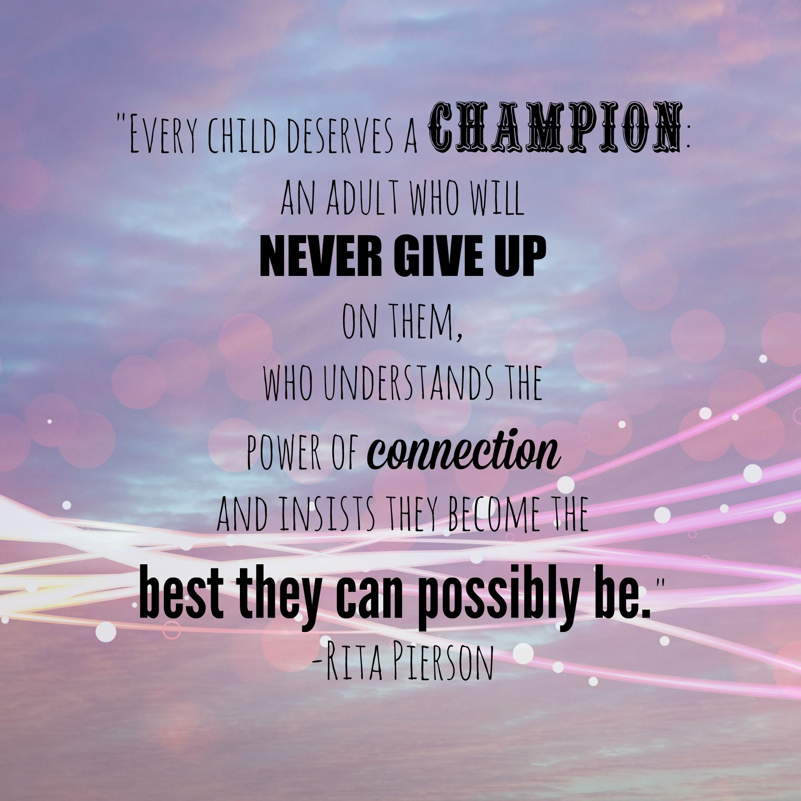
What is at the heart of everything?
Successful Learners
Confident Individuals
Responsible Citizens
 | R | esponsible
 | E | nable
 | L | augh
 | A | chieve
 | T | hrive
 | I | ndependence
gr | O | w
 | N | ow and in the future
 | S | afe
 | H | appy
 | I | nclusive
 | P | ersonalised
 | S | uccessful

Slide 12
Rationale
Why
Values
Passion
Lack of provision
Why now
Expertise and experience
NCC Sufficiency Planning
Opportunity

Slide 13
Implementation
Students
EHCP – C&L + SEMH
LA admissions
On roll at Isebrook

Slide 14
Implementation
Environment

Slide 15
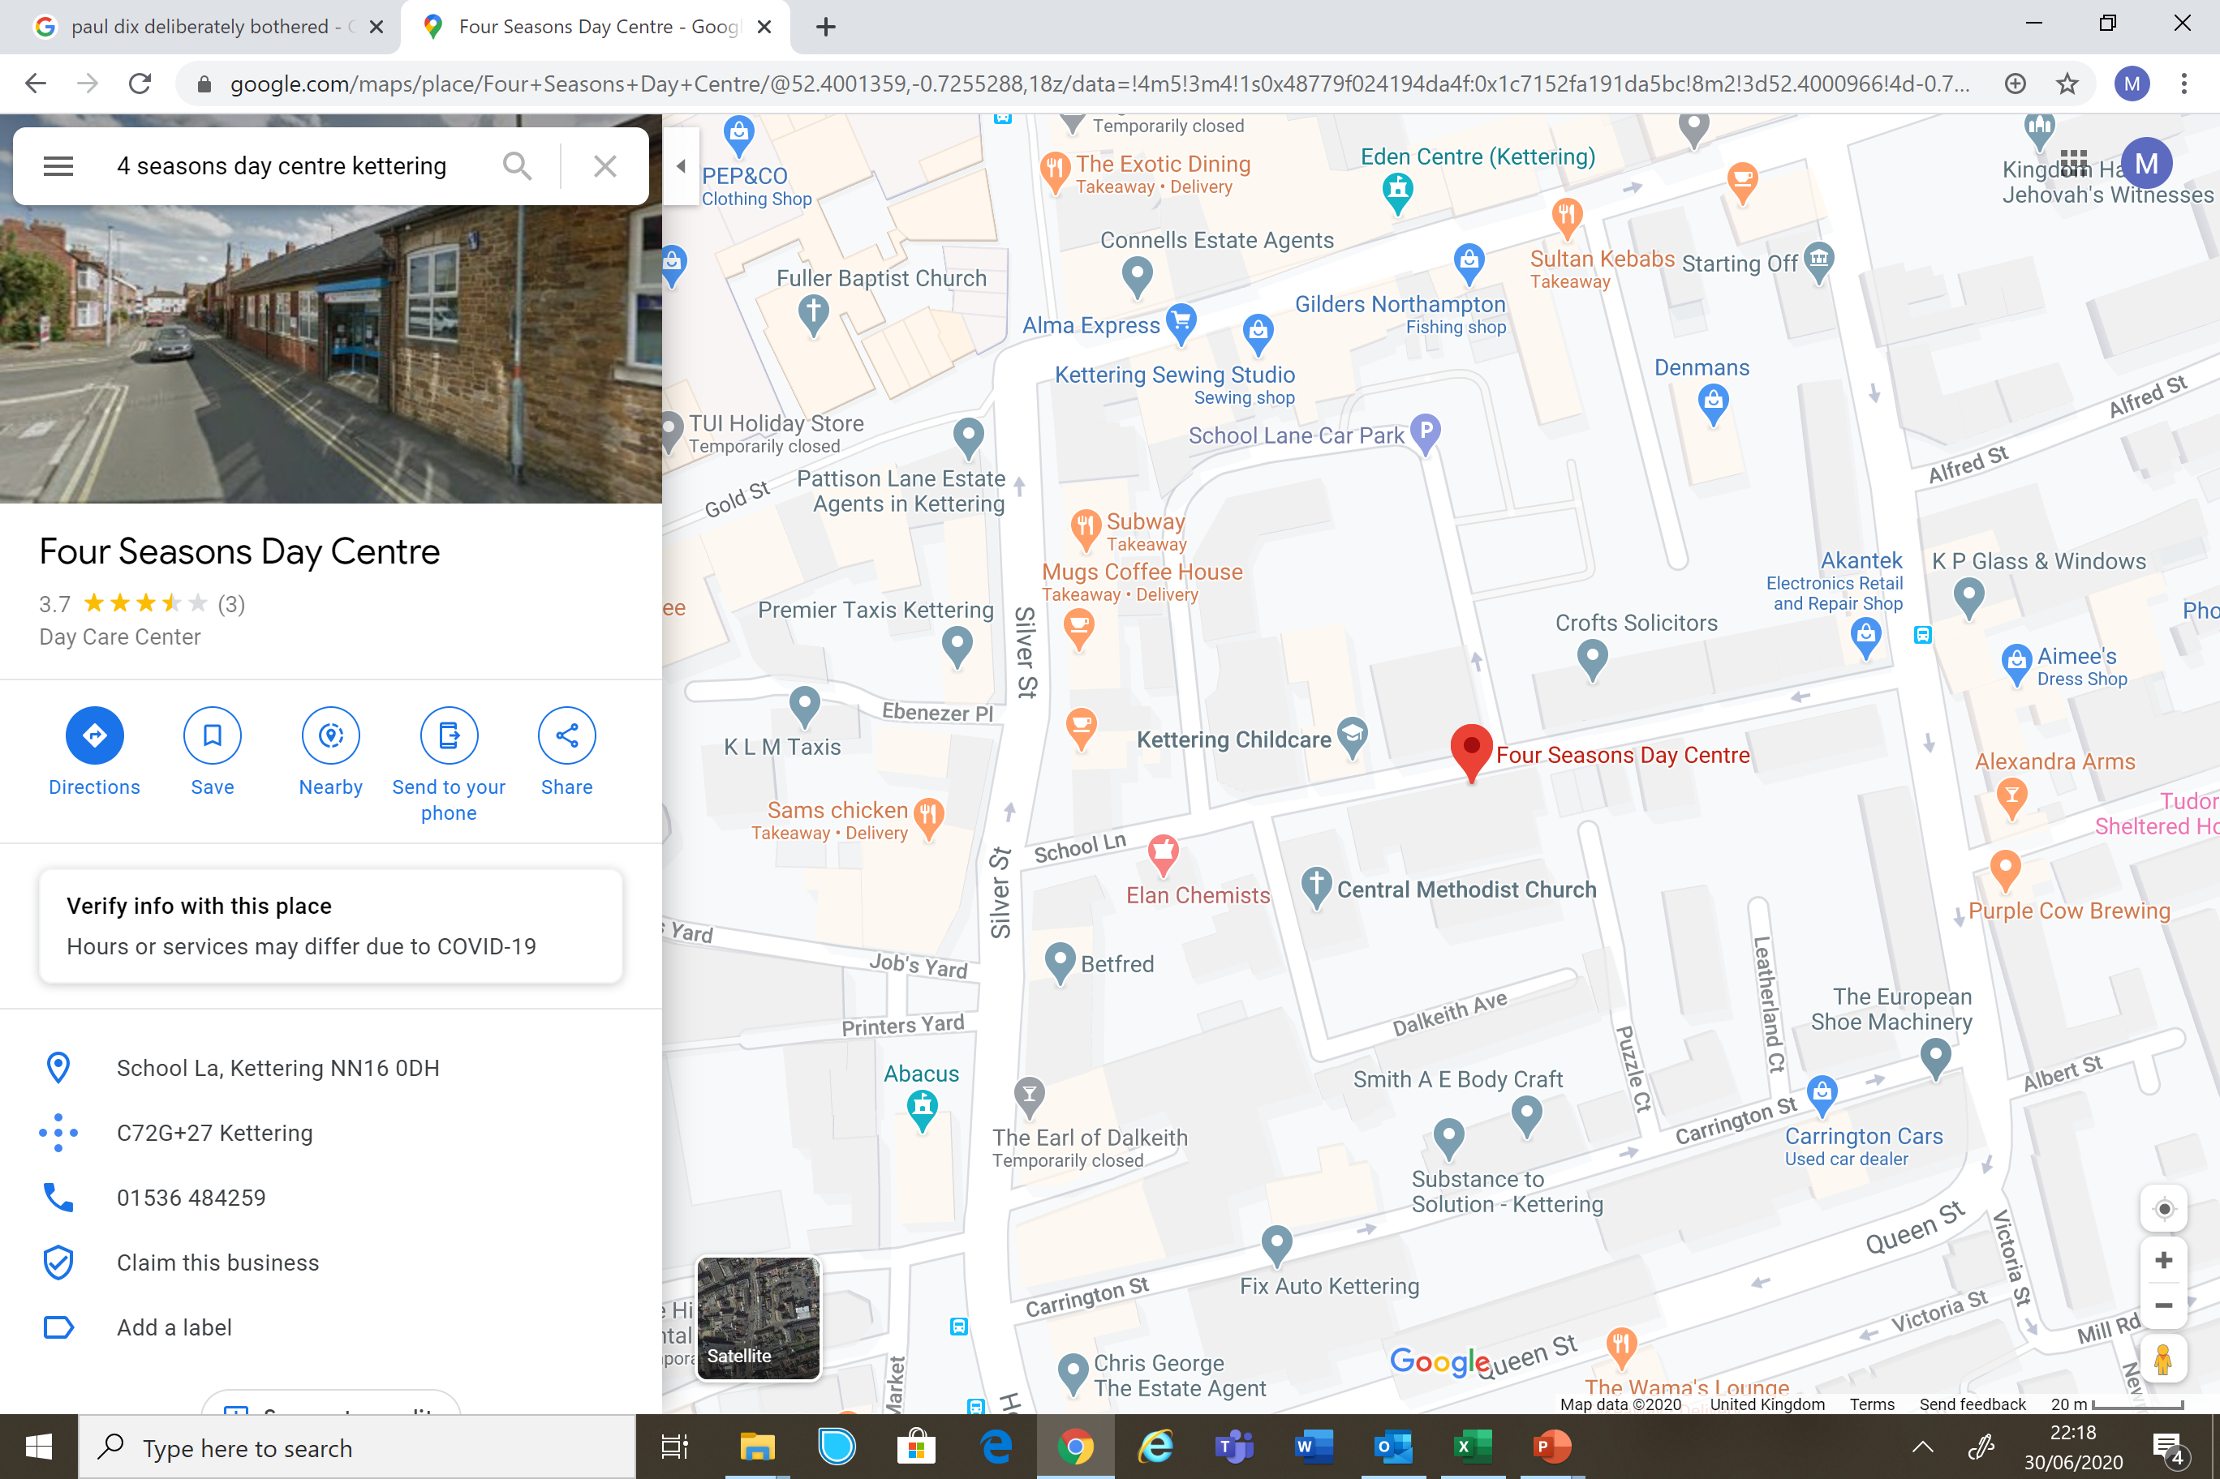

Slide 16
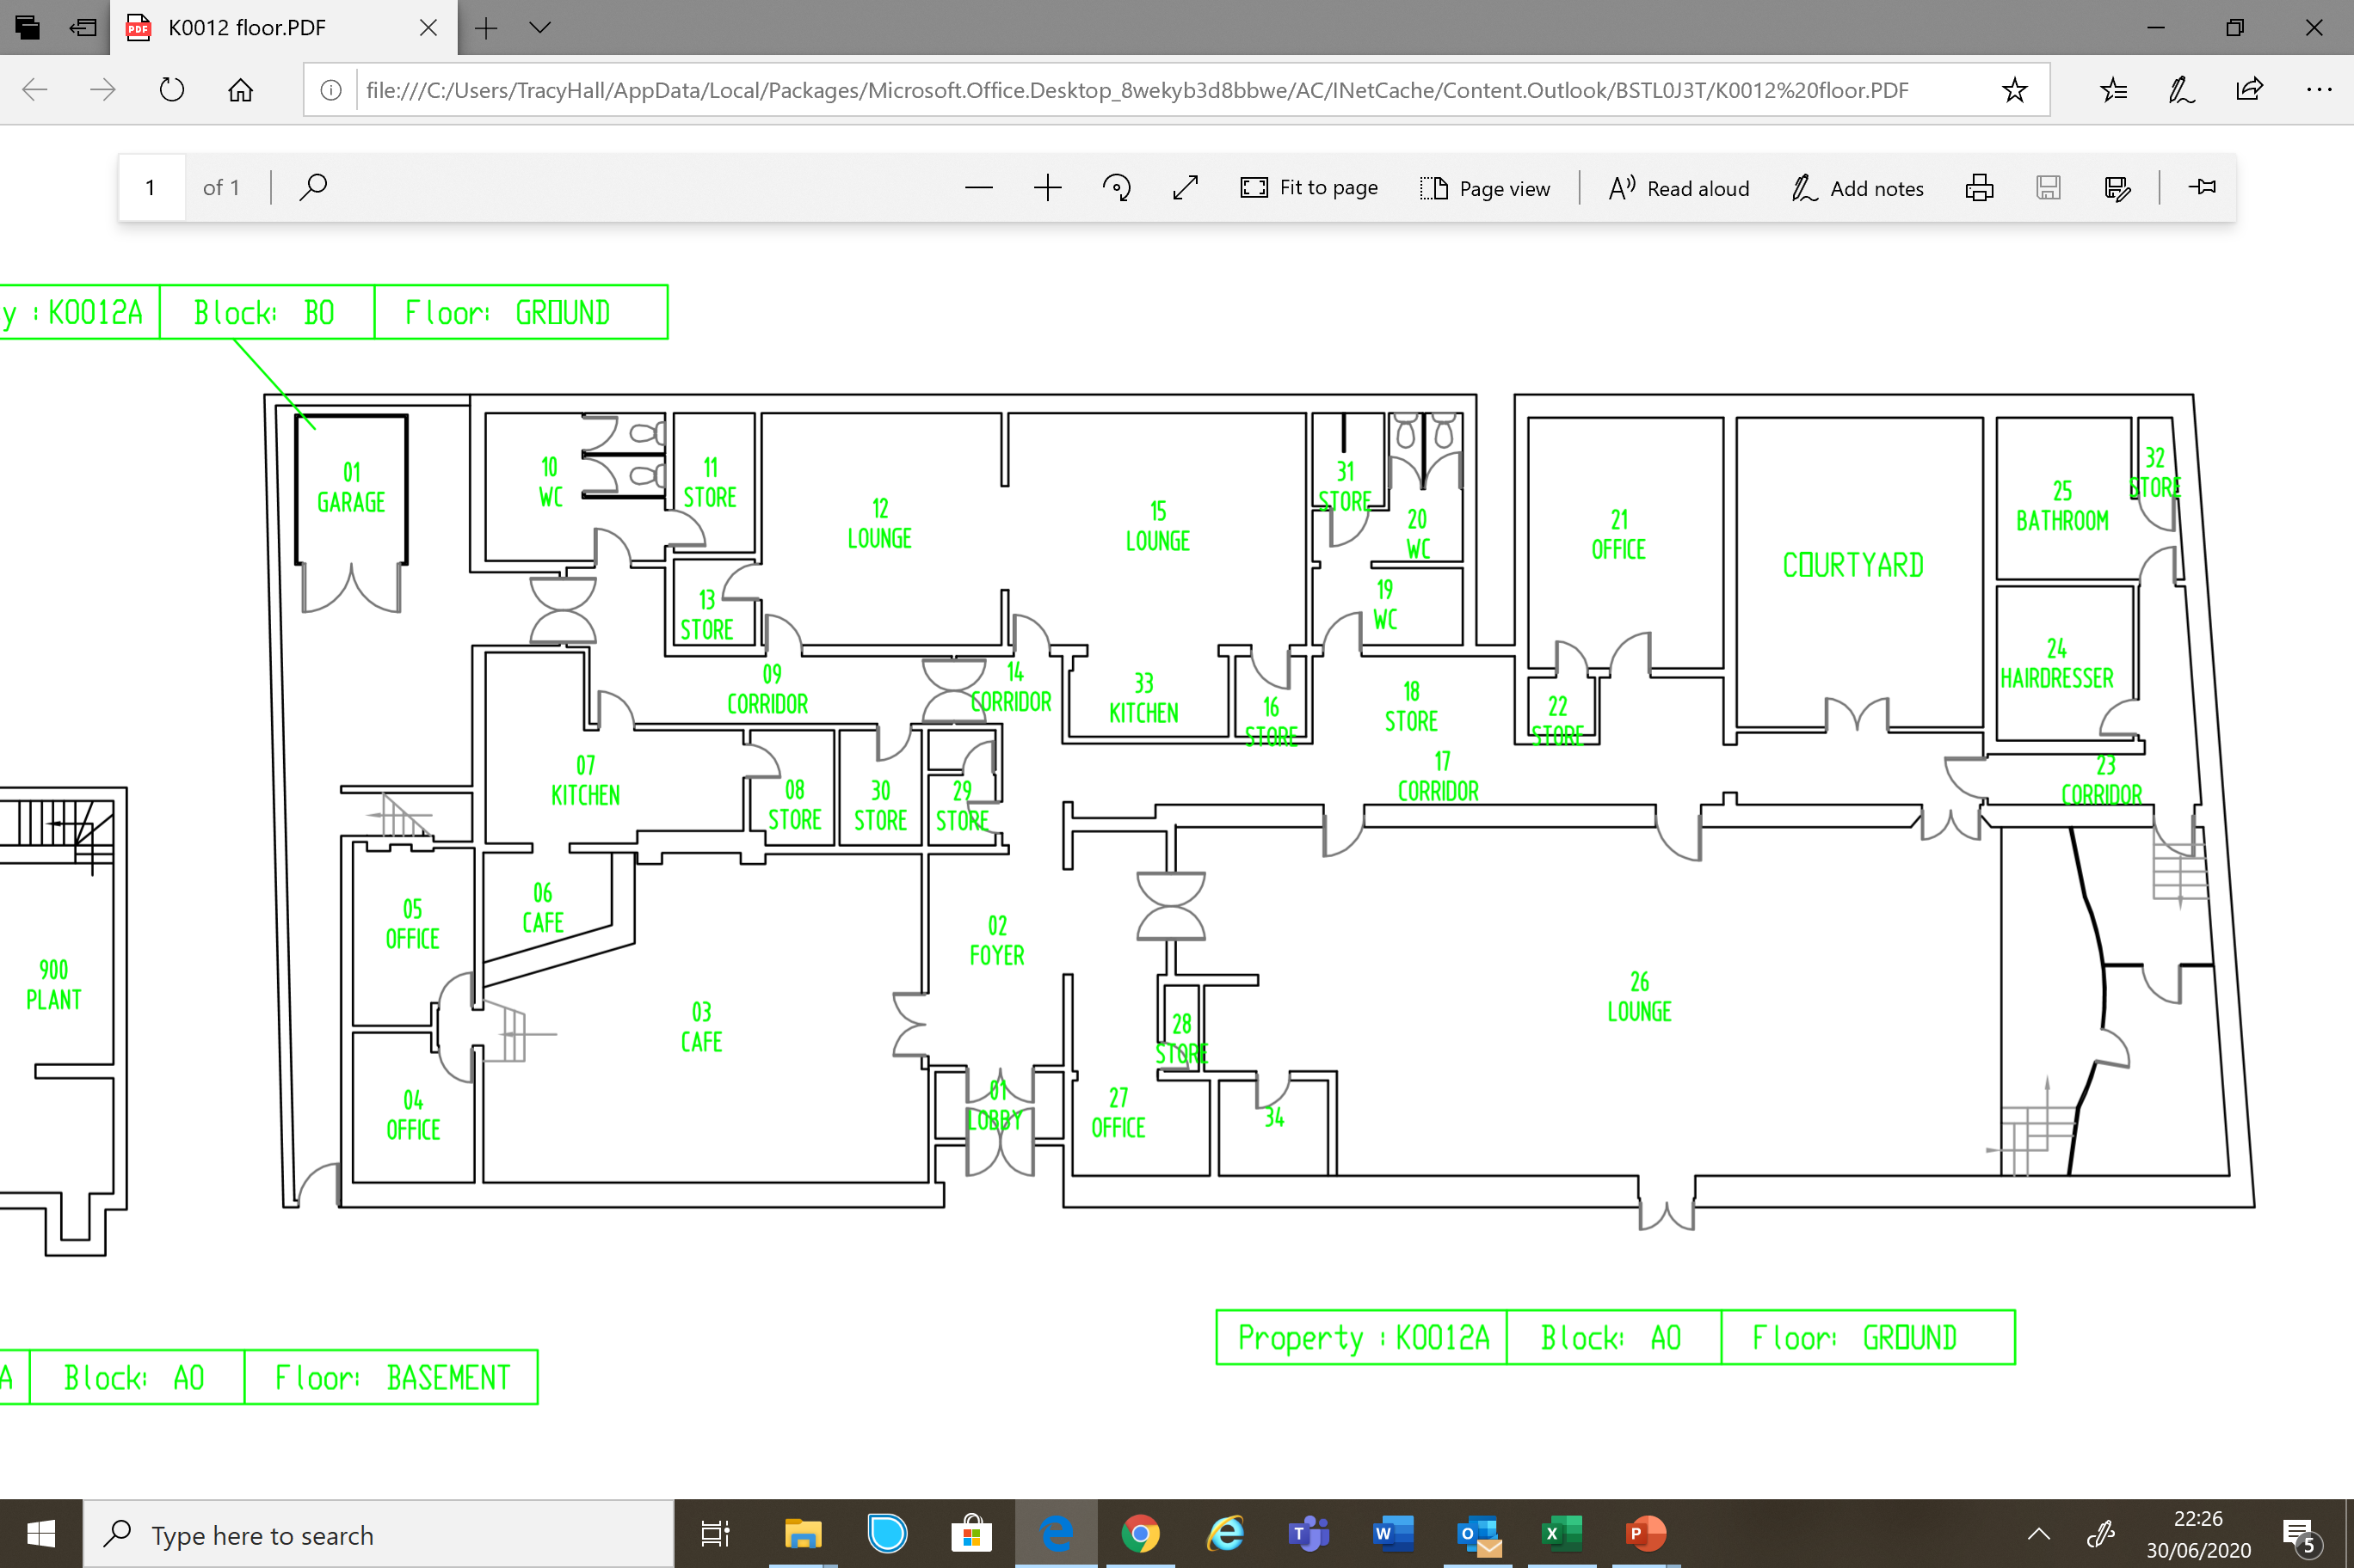

Slide 17
Implementation
Curriculum

Slide 18
Social Capital
Bonding - networks and ties within communities
Bridging - networks and ties between different communities
Linking - networks and ties that cut across status and similarity
(e.g. between students and adults)

Slide 19
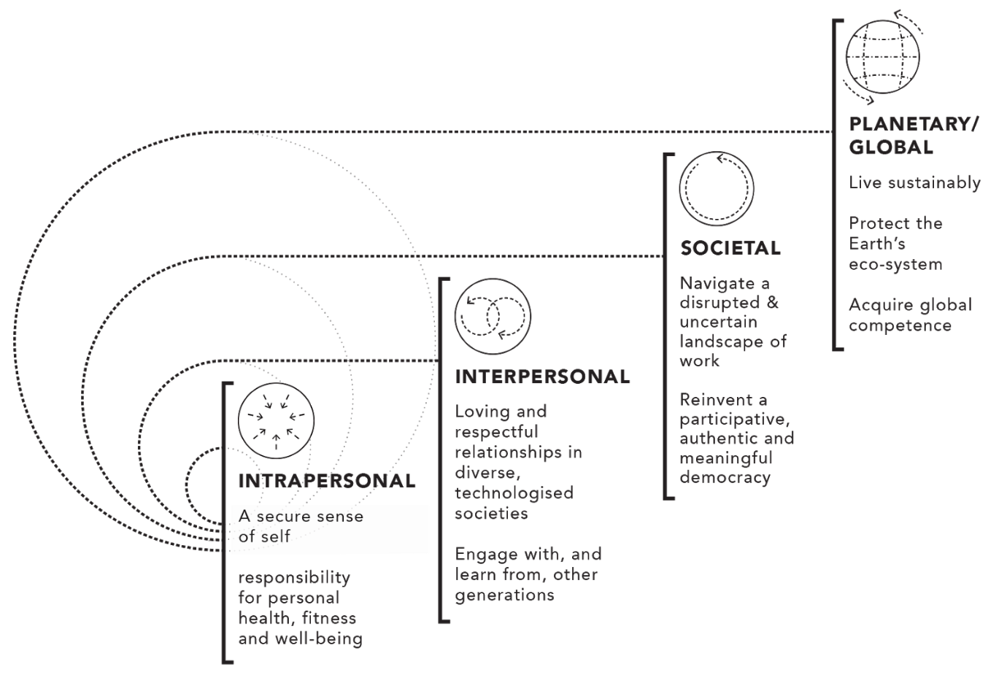
SOCIETAL
COMMUNITY

Slide 20

SOCIETAL
Caring for others and a sense of greater purpose
Working together for the benefit of others
COMMUNITY
Respectful and beneficial relationships in diverse societies
Working together to support each other
INTERPERSONAL
Caring and respectful relationships
Engage with, and learn from, other people
INTRAPERSONAL
A secure sense of self
Responsibility for own actions, health, fitness and well-being

Slide 21
Our Curriculum Philosophy
Skills Builder | Me | We | Our | Your
Leadership
Presenting Creativity
Aiming High Staying Positive Teamwork
Listening Presenting
Development of self | Being Doing Thinking | Power and Identity | Skills and Structure | Interdependence
SOCIETAL
Caring for others and a sense of greater purpose
Working together for the benefit of others
COMMUNITY
Respectful and beneficial relationships in diverse societies
Working together to support each other
INTERPERSONAL
Caring and respectful relationships
Engage with, and learn from, other people
INTRAPERSONAL
A secure sense of self
Responsibility for own actions, health, fitness and well-being

Slide 22
Implementation
Curriculum
Timetable
Personal
Academic
Vocational
Duke of Edinburgh
Personalisation
5 Key areas
Land based incl
Catering
Creativity
Technology
Sports

Slide 23
Implementation
Staffing
Connected Provision Leader
Teacher input
Team of teaching assistants:
Level 4
Level 2
Connected provision with Isebrook
Specialist teachers, pastoral and therapeutic support

Slide 24
Next steps
Short term
Consultations (10 students)
Person Centred Planning meetings
Curriculum
Recruitment
Premises

Slide 25
Next steps
Medium term
Developing the 5 key areas for personalisation
Quality assurance

Slide 26
Next steps
Long term
25 students
Outreach support
Explore AP registration

Slide 27
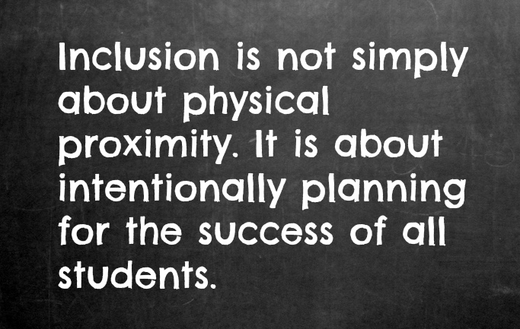
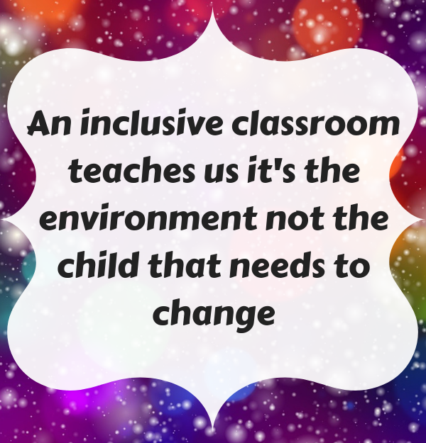
In a nutshell
Isebrook School

Slide 28


tracy.hall@isebrook.co.uk
klatham@creatingtomorrowmat.co.uk

