Slide 1
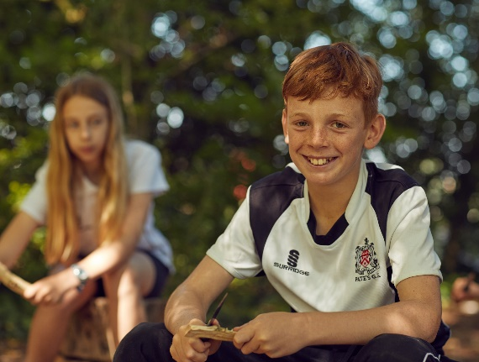
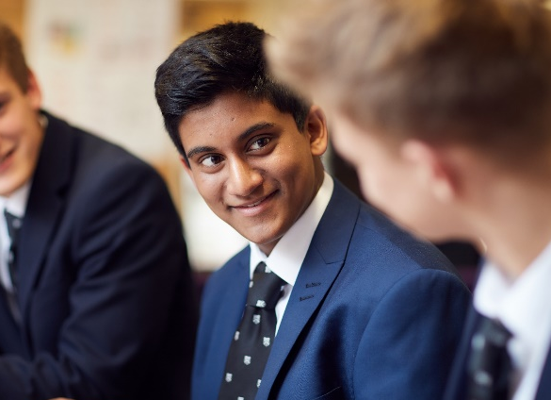
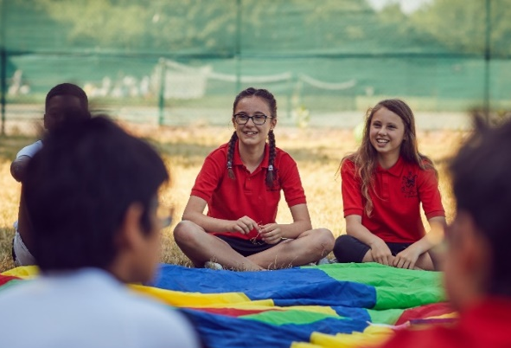
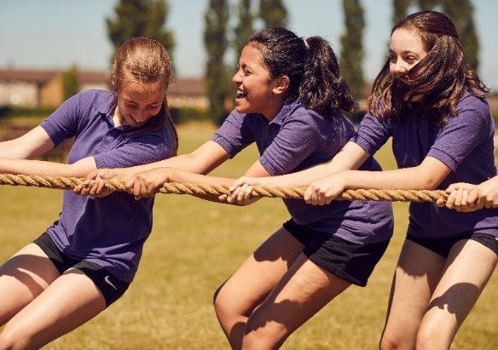
Teaching Assistant

Slide 2
The Job
JOB/PERSON SUMMARY
A Teaching Assistant is required for September 2022, to support a pupil with Special Educational Needs and general classroom duties. Pate’s is looking for a Teaching Assistant for 32.5 Hours (Monday - Friday 8.40am-3.40pm), to join a team of enthusiastic support staff. The position is temporary until the end of Term 6 and term time only, with the possibility of the contract becoming permanent. The successful candidate will have energy and enthusiasm, with existing expertise or qualifications relevant to the role of a supporting a student with Autism Spectrum Disorder.
APPLICATION PROCEDURE
For further information, a Job Description, Person Specification and a Job Application form can be found on the school website http://www.patesgs.org/ . Completed applications should be sent by email to: jobs@patesgs.org or by post to: Pate’s Grammar School, Princess Elizabeth Way, Cheltenham, GL51 0HG.
DUTIES
This job description describes in general terms the normal duties which the post-holder will be expected to undertake. However, the job or duties described may vary or be amended from time to time without changing the level of responsibility associated with the post.
Also included in the duties of the post-holder are the 24 non-teaching tasks transferred from teachers to support staff in accordance with the workforce remodelling agenda.
Teaching and Learning:
Assist in the educational and social development of pupils under the direction and guidance of the head master, SENCO and class teachers.
Assist in the implementation of Individual Education Programmes for children and help monitor their progress contributing to review meetings as appropriate.
Provide support for individual pupils inside and outside the classroom to enable them to fully participate in activities.
Work with other professionals, such as speech therapists and occupational therapists, as necessary.
Assist class teachers with maintaining pupil records.
Support pupils with emotional or behavioural problems and help develop their social skills.
Assist teachers in maintaining high expectations and levels of behaviour.
Standards and quality assurance:
Support the aims and ethos of the school.
Set a good example in terms of dress, punctuality and attendance.
Attend team and staff meetings, if appropriate.
Be proactive in matters relating to health and safety.
Other duties and responsibilities:
To be aware of school procedures and support the work of the school, as outlined in policy documents and the School Development Plan.
To have due regard for issues of confidentiality, referring parents to the class teacher or head master and to report appropriate information from parents, or outside agencies to the class teacher.
To understand the regulations with regard to child protection and safeguarding of children

Slide 3
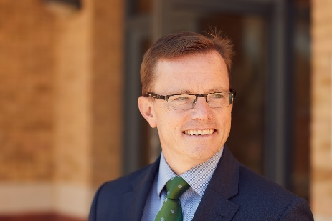
Welcome from the Headmaster
Thank you for showing in an interest in working at Pate’s. Our website will allow you to explore our vision and values in detail. This booklet is designed to give you a flavour of what it is like to join our strong community of over 150 exceptional staff.
Over the last few years we have, again, been named as the Sunday Times ‘National School of the Year’. Our examination results see us as the highest achieving co-educational school in the country and the best school outside of London. I am proud that the students and staff achieve so much, but this does not drive us. Rather, it is the positivity and sense of fun that you will feel when you visit us that makes Pate’s such a special place to work. We call it ‘The Pate’s Way’ and you will feel it when you visit the school.
You will notice the quality of relationships between all members of our school community. Students and staff are motivated; they look after and challenge each other. Our students are quite simply the best of their generation. They are inspiring young people, it is truly a privilege to work with them.
We recognise that our staff are main our reason for our successful and happy school. Both teaching and support staff are committed and hardworking, all believing firmly that we should help students to be and do their best. Pate’s prides itself on attracting and retaining staff of the highest quality.
Recently accredited as a Teaching School Hub, we have a reputation for promoting professional autonomy and for investing in staff through the provision of high quality development opportunities. Joining us gives staff the opportunity to work in an outward facing school that treasures and cherishes the best of the past, yet looks to embrace and be at the cutting edge of national and world educational developments.
As Head, I promise whoever is appointed in this exciting role every support I can offer – if you would like to talk through the post prior to application, then please don’t hesitate to contact the school. Tours of the school can also be arranged, we would be delighted to show you around.
Thank you again for your interest in the post – please don’t hesitate to get in touch.

Slide 4
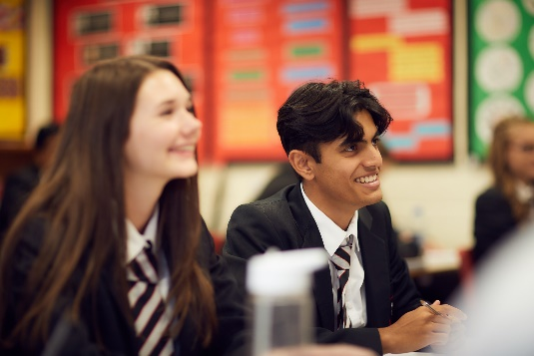
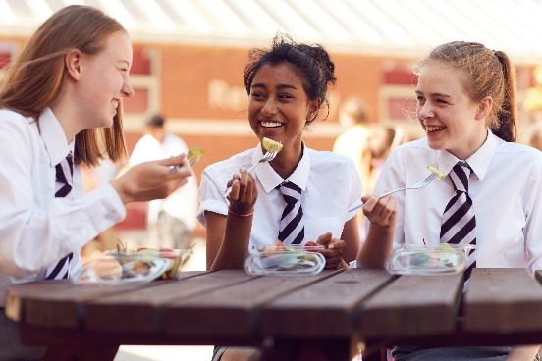
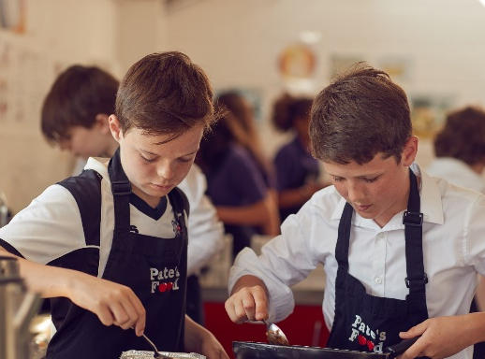
Learning at Pate’s
Pate's is a unique and special place to learn. This doesn't happen by accident. We take a holistic view of learning, emphasising the rewards of deep understanding of the subject, instilling a love of learning and its challenges. We aim to cultivate in our students life long skills of aspiration and resilience, setting challenging but manageable tasks and using appropriate praise to build pupil self-esteem. We ask students to see failure as a key part of the learning journey. Students and staff alike are encouraged to take risks and to try new things, to be creative, solve problems and to inspire others around them. We recognise the importance of metacognition and reflection, and we encourage students to use a wide range of thinking approaches. We have high expectations of staff and students alike; our students are encouraged to take responsibility, articulate views, ask questions and lead their peers. Collaboration, feedback and support also sit at the heart of our Pate’s Learning Framework, our community's agreed definition of world class learning that sits visibly in every classroom. However, learning isn't restricted to the classroom environment; our students equally develop their skills in the broader contexts of co-curricular activities and self study. We do not believe in setting homework for the sake of it, but instead when the time is right and when it helps pupils make progress in their learning, whether that be in their knowledge, skills, understanding or in their own personal growth.
In July 2019, Pate's was delighted to receive the High Performance Learning (HPL) World Class School Award in recognition of our learning ethos. One of only nine schools to receive this around the globe in 2018/19, this award recognises the very best schools in the world and is designed for those at the forefront of educational thinking. HPL’s Founder and CEO, Professor Deborah Eyre said:
“I am absolutely delighted to confer HPL World Class Award Status upon Pate’s Grammar School. This recognises Pate’s commitment to embedding HPL as part of the school’s DNA, as part of its quest to develop world-class learners. Their adoption of HPL, building on past success, is ensuring that Pate’s students are impressive and flexible learners, who I have no doubt will leave Pate’s college-, career- and life-ready.”

Slide 5
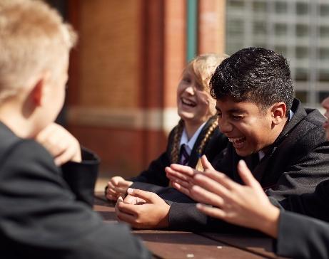
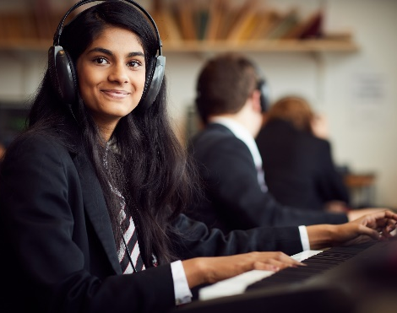
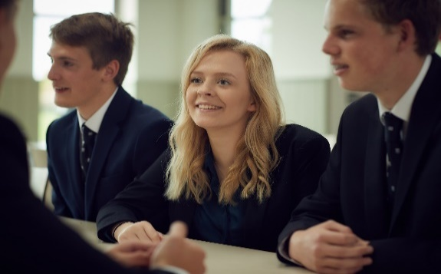
Pastoral care at Pate’s
We are proud of the exceptional pastoral care our students (and staff) receive and we invest considerable energy and resources in their wellbeing. Our 2025 vision sets out 3 core aims in this area:
We are a mutually supportive community with shared vision and values;
We are a school where welfare is at the heart of decision-making, with physically and mentally well students and staff;
Everyone in our community is known as an individual and supported to achieve their full potential.
In year 7, our number one priority is for students to feel happy and settled when they first arrive. Students joining us at age 11 are supported by their Form Tutor, a specialised Head of Year 7 and a team of Year 11 mentors. From year 8 through to year 11, students usually then retain the same tutor and Head of Year wherever possible, allowing lasting trusting relationships to grow and develop before our team of Sixth Form specialists take over in years 12 and 13.
All pupils at Pate's have weekly access to a school nurse and counselling is also available for students who are identified as needing additional support. For a small number of students with particular health or medical needs, additional support from our 'Hub' is also available. Staffed by specialists, this supportive environment ensures that we are able to individually nurture and support all students in our care.
'Supporting Each Other' is at the heart of our School Vision, and at the heart of what we do as a school. We are a school built on relationships and respect, rather than rules and we think this makes us a very special community to be a part of.

Slide 6
SEND at Pate’s
It is our vision to develop a culture of diversity and inclusion within the school where all students feel fully accepted as individuals and are able to participate fully in Pate's life. We are committed to removing barriers to learning and ensuring access for all pupils; all pupils with special educational needs or disabilities (SEND) are valued and respected members of the school.
Whilst Pate’s is a selective grammar school, some pupils have specific learning difficulties, communication and interaction difficulties, social, emotional or mental health difficulties, a disability, or medical condition which can affect learning. As a school we are committed to supporting all students to achieve their full potential and the principles of inclusion of SEND students will be applied to all students needing additional help and support even if only for a short length of time.
Our SENDCO coordinates SEND Provision across the school and our TAs work with students who have specific needs and/or an Education, Health and Support Plan (EHCP). The majority of student needs can be met by Quality First Teaching within the classroom, but a few students may require further individualised support.
We also have a staffed Pastoral Hub for students who require individual support at times during the school day.

Slide 7
Co-curricular at Pate’s
The provision of co-curricular activities at Pate's is unrivalled by any other state school, regionally or nationally. During lunch times and after school Pate's buzzes with activity, allowing students to be creative, perform, play sport and be active to their heart's content. Indeed, so committed are we as a school to a true breadth of education, that on Tuesday afternoons lessons are suspended, allowing all students to access the 'exceptional range' (Ofsted) of enrichment activities that are on offer. Furthermore, for two weeks each summer, 'Activities Fortnight' allows students in years 7 - 10 to participate in an additional myriad of exciting opportunities.
We are often asked 'Do you have a club for X?'. The answer is 'probably' – however, if not, then students with a particular passion are simply encouraged to start one. In the 6th Form, the year starts off with a 'Societies Fair'. In addition to teacher-led programmes, Sixth Form pupils run, manage and facilitate 30+ student-led societies, often inviting in external speakers such as local MPs or professionals to talk and debate with; the possibilities are simply endless. The year 12 pupil who sings in choir on a Monday, may well be at Economics Society during lunch time on Tuesday and reading with pupils in a local primary school on a Tuesday afternoon. On a Wednesday they may then represent the school playing hockey, before staying after school on a Friday to lead a section of our CCF. At Pate's we work hard and play hard, but, most importantly, we have a lot of fun along the way.

Slide 8
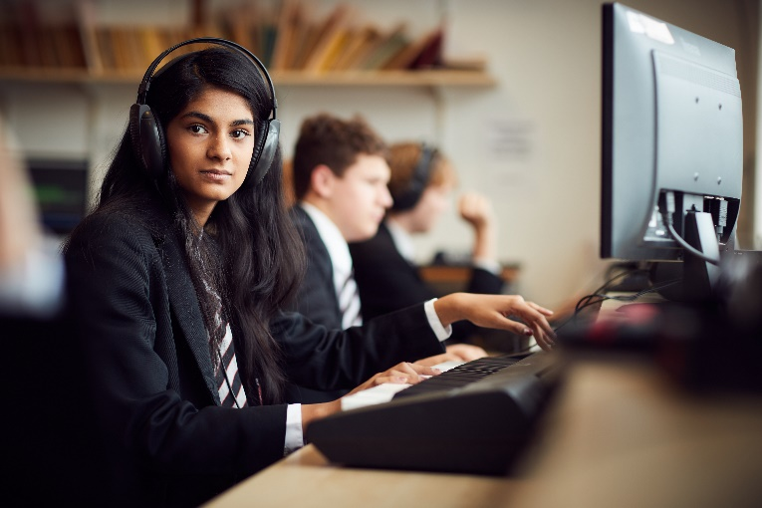
Technology at Pate’s
The provision of IT resources at Pate's is exceptional by state school standards. We have seven specialist network rooms with over 200 desktop PCs between them, available for staff to book for their lessons. In addition, there are a large number of PCs in our newly-built sixth form building, and further PCs and Chromebooks available in various specialist subject areas such as music and the libraries.
All staff receive their own laptop for use at home, as well as having desktop machines available in every classroom. Staff and students can use Citrix as a means of gaining remote access to their school desktops when away from school. All hardware and software is regularly updated and replaced by our IT support team consisting of, the network manager and two further full-time IT technicians, who work alongside the Head of Computing, the SIMS manager, and others.
We value our website as a vital means of communicating the Pate’s brand to parents and other external stakeholders, alongside our social media presence.
Within the school community, we have a Microsoft Office 365 licence which enables us to make extensive use of Teams, SharePoint, Forms and other related software. This has been a huge growth area over the last year, and has enabled students to continue to receive their full timetable of lessons via remote learning.
Our MIS is SIMS, and we have worked closely with Capita as a SIMS Partnership school.

Slide 9
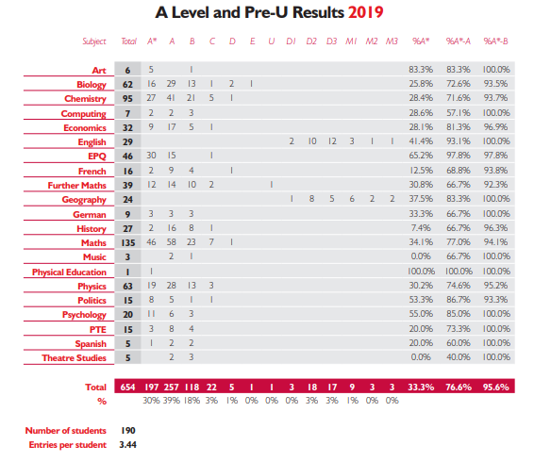
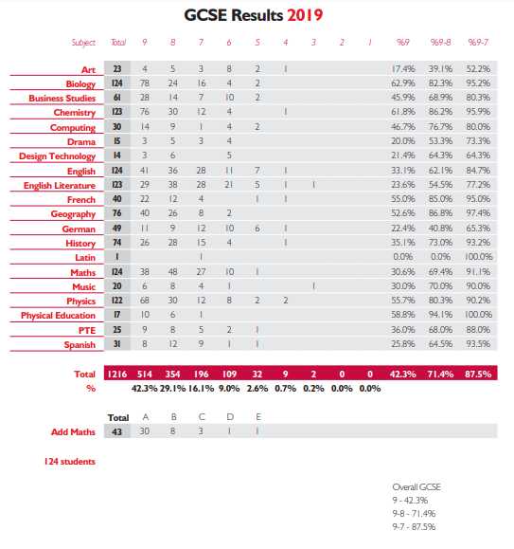
Academic outcomes
We are very proud of our exceptional and almost unrivalled academic outcomes, both in terms of attainment and progress. These outcomes alone do not make Pate's the very special school that it is, however, undoubtedly they open doors for our students and are testament to the hard work of all students and staff in our community. Our results in 21 and 20 (like those in all schools) were exceptional. Below however are our equally outstanding results from 2019 – when our performance in fair and comparable exams was truly ‘world class’.

Slide 10
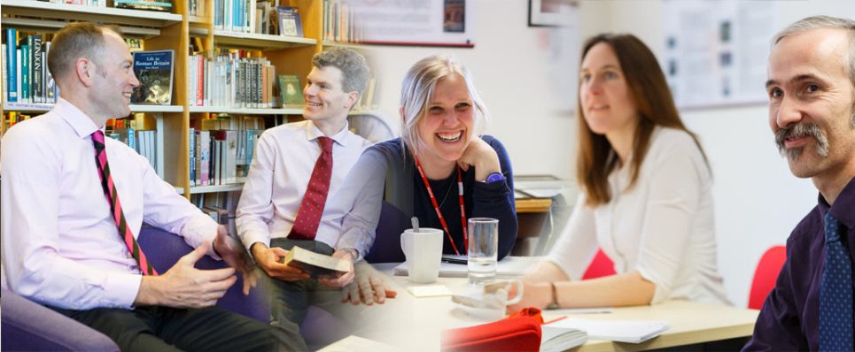
Why work at Pate’s?
Highly motivated and engaged students - the best of their generation!
A culture of professional autonomy and a supportive staff team - you join a real ‘Pate’s Family’
As a Teaching School Hub we develop and support our staff (teaching and non-teaching) at every stage of their career
We recognise that our staff (like our students) have other commitments away from school and are entitled to a healthy work-life balance and we support our staff with family or other commitments wherever possible
FREE access to the onsite school gym
Modern, purpose built accommodation with FREE onsite parking and good access to both the M5 and Cheltenham Station
Well resourced departments and access to a high quality library for both professional and personal use. (This is thanks to additional funding we receive from a variety of sources.)
Childcare voucher scheme
Longer holidays than many other state schools

Slide 11
Career development opportunities
"In part due to the excellent personal development programme for support staff, but also due to the open door policy of senior staff, I feel supported in my development and confident in my abilities. Despite having been a full-time mum for a number of years before I arrived and feeling slightly nervous about being back in the workplace and the various challenges that would entail, I have felt valued and supported (as well as challenged!). It has never been a problem for Pate's to accommodate the changing needs of my family life. Consequently Pate's does feel like an extended family, so I feel I have the best of both worlds. I can honestly say that the more I have put into the school, the more I have got out of it “
Pate’s commits a large amount of money and time to staff development. As the lead school for the Odyssey Learning Alliance and also the new Odyssey Teaching School Hub, the newly appointed Assistant Head will benefit from opportunities to:
Access national NPQ qualifications and a range of other leadership programmes offered by both Odyssey and the GSHA, ASCL, SSAT etc;
Attend and facilitate CPD sessions both within school and across the county and SW region;
Network with other local Senior Leaders from a range of sectors;
Undertake work for Pate’s International, working alongside teachers from our partner schools in China.

Slide 12
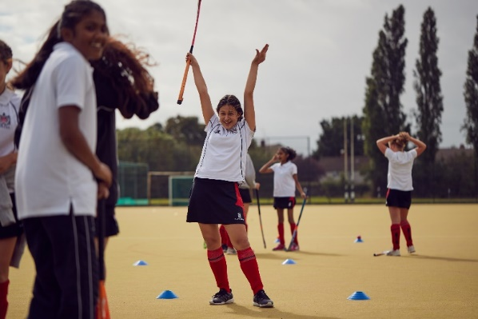
Want to apply or know more?
Applications
Applications should be by Pate’s application form and covering letter, emailed to jobs@patesgs.org
Further Information
We welcome questions and queries from prospective applicants. Please don’t hesitate to contact Francesca Coppola (PA to the Head) at jobs@patesgs.org if you would like to ask a question, arrange for an informal chat or request a tour.

